Slide 1
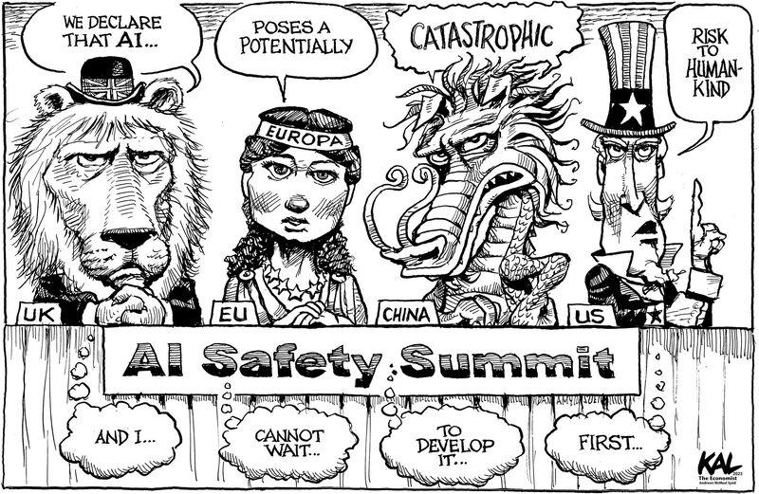
Artificial Intelligence regulations at
Corvinus University
Csaba Csáki
Dean for Artificial Intelligence
Head of the Artificial Intelligence Integration Centre
Presentation for Online Training
© Kevin Kallaugher

Slide 2
Why are we talking about AI…?
The last two decades wittnessed the increasing dominance of various waves of Artificial Intelligence and related technologies
Big Data /
Machine Learning
Generative Tools / LLMs
AI Agents and Agentic Framework
These technological innovations are not only "disruptive"
but also have substantial impact on the natural and societal environment – and both technological innovations and socio-economic changes that follow are happening very fast causing substantial uncertainty

Slide 3
How Corvinus regulations are shaped…
EU and national laws
A) AI Regulatory Framework
(all types of AI in all activities)
Technological advances
Ethical considerations
Machine Learning
Gener-ative
Agentic Framework
Pedagogical methods
Environmental concerns
Learning Teaching
Research
Operations
Marketable skills and competences
B) VRAP Provisions
C) Individual study programme and subject level responsibilities
3

Slide 4
Basic principles of Corvinus regarding GenAI
Corvinus University of Budapest is committed to technological innovation and supports using artificial intelligence (AI) tools
in all its activities, including learning, teaching, research and operations
In the context of the rapidly evolving field of generative artificial intelligence (GenAI), the University encourages its students and staff to explore, experiment with and learn more about the use and development of these tools.
However, GenAI tools should also be used responsibly and as allowed in a given context: use them ethically, efficiently, and sustainably – and be critical

Slide 5
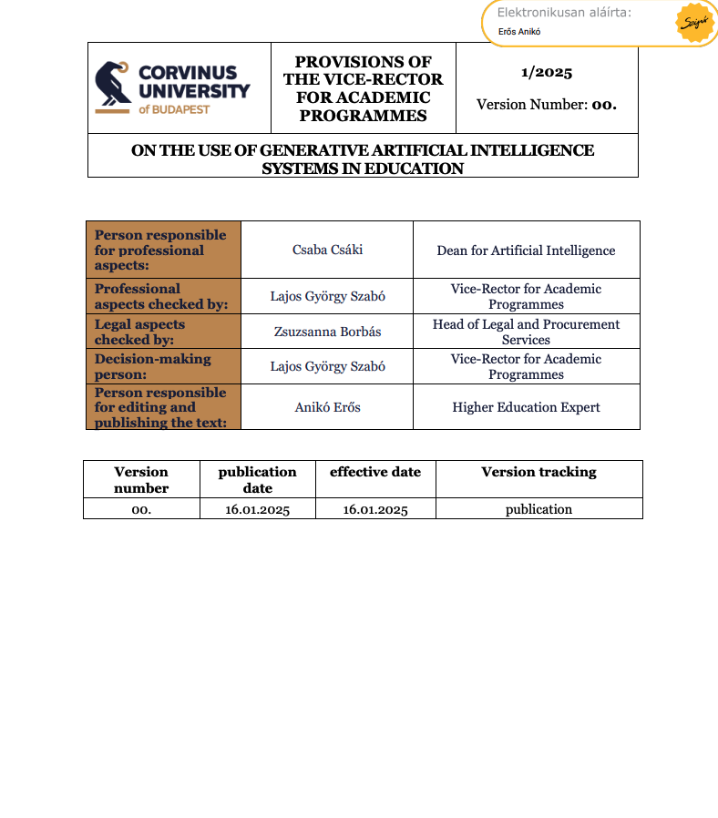
6/2025 VRAP Provisions on GenAI in Education –September 2025 (first issued in January as 1/2025)
Every Corvinus community member is responsible for the ethical, efficient and sustainable application of generative AI in learning and teaching
To achieve this and to clarify the rules of responsible use, the Vice-Rector for Academic Programmes (VRAP) has published the regulations that guide the use of AI in the context of education
“6/2025 Provisions by the Vice Rector for Academic Programmes on the use of generative artificial intelligence systems in education”
is in force and available on the university web page
https://www.uni-corvinus.hu/downloads/bmcf.dv0g6g/6-2025-orh-rendelkezes-mi-hasznalat-00-en-sgd.pdf
https://www.uni-corvinus.hu/downloads/bmbm.gxqlcb/6-2025-orh-rendelkezes-mi-hasznalat-00-ai.pdf

Slide 6
What is in the regulation (6/2025 VRAP)
We encourage all students to familiarise themselves with these rules and
use generative AI responsibly.
Subject leaders declare in writing – in the syllabus
or no later than the first week of lectures in some other written form –
how students may use generative AI in the context of that subject.
Students should only use GenAI in completing
performance evaluation exercises if it is
clearly allowed by the subject leader or teacher.

Slide 7
What is in the regulation (6/2025 VRAP)
Subject requirements may specify the need for ethical statements
regarding the use of AI during the completion of assessments, projects or exams
  the statement could be about a declaration that the student did not use GenAI,
  or, if use is allowed, the requirements will clarify up front
  which tools may be used, for what and
  what data is required in the statement.
If something not clear or in case of doubt, please
ask the course leader or lecturer for clarification.
To ensure that no suspicion arises regarding the disallowed use of GenAI
(and to show progress), students may consider
saving versions of their work or using tools that track their activity.
  It is advisable to discuss such options with your lecturers.

Slide 8
Update of the regulation (September): key changes for students
It is acknowledged that GenAI is now more and more used in co-creation
  §7 (3) c): application and declaration are context-dependent (i.e. may vary by subject)
It is now clarified that in case of suspicion of non-permitted use (§18 (6))
  A) lecturers may initiate a dialogue with the student to clarify
    In case of clear evidence and lack of student cooperation, ethical proceedings may be initiated
  B) students may offer evidence to prove lack of wrongdoing
New, simplified declaration examples are provided (Appendix)
  These may be modified by subject leaders as necessary

Slide 9
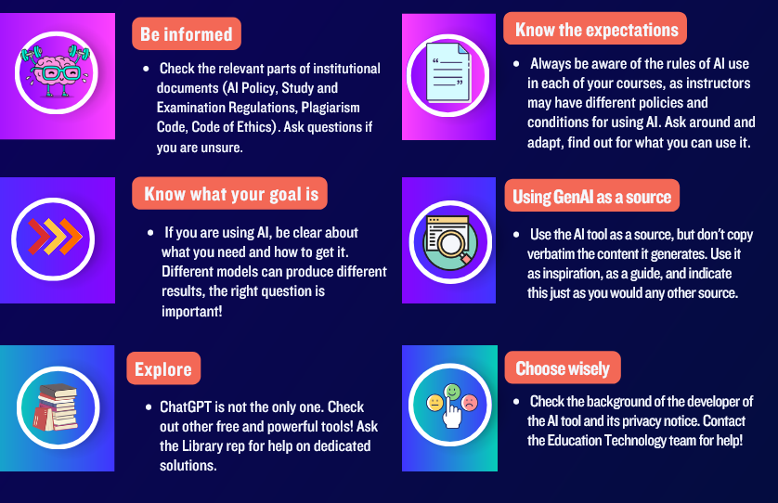
Always exercise Critical Thinking
Be discerned about input/output
9

Slide 10
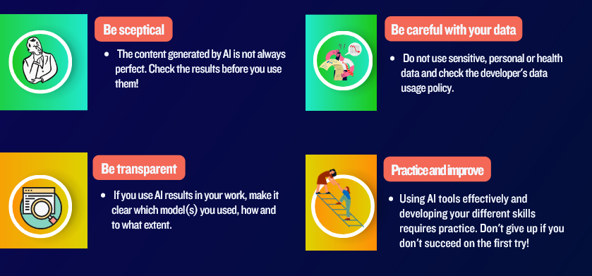
Always exercise Critical Thinking
Be discerned about input/output
10

Slide 11
Thank you!
Csaba Csáki
Dean for Artificial Intelligence
Artificial Intelligence Integration Centre

Slide 12
How Corvinus regulations are shaped…
EU and national laws
Ethical consider-ations
Environ-mental concerns

Slide 13
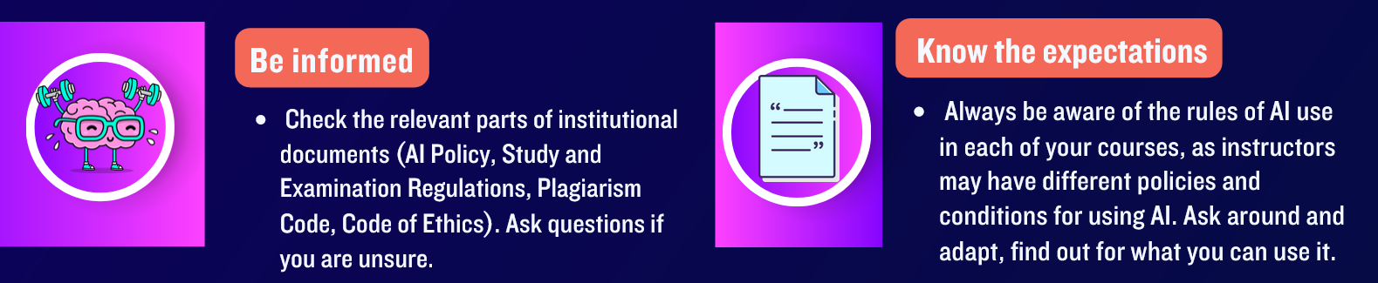
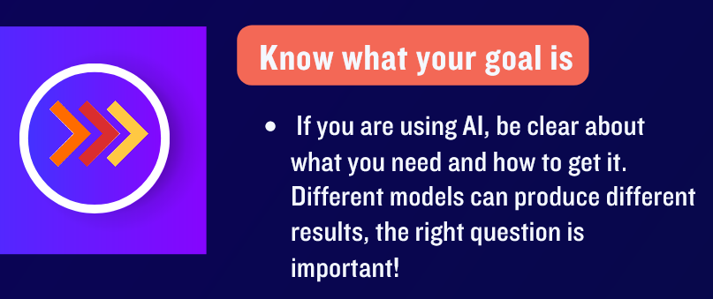
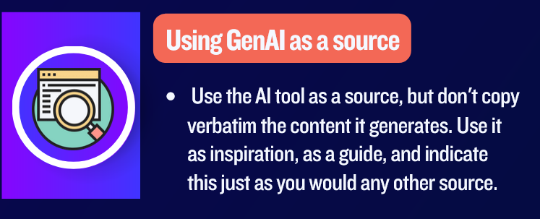


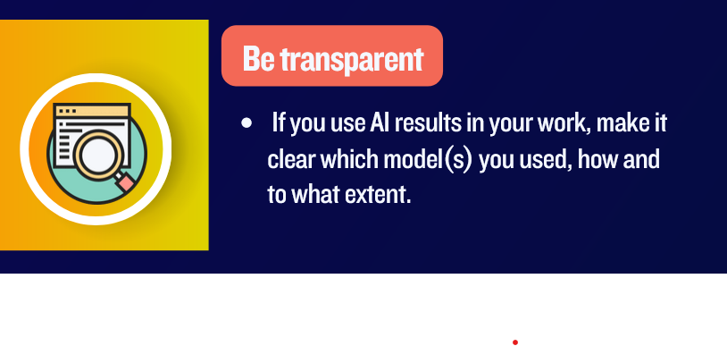
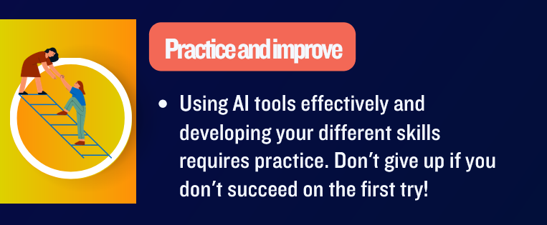
Always exercise Critical Thinking
Be discerned about input/output

Slide 14
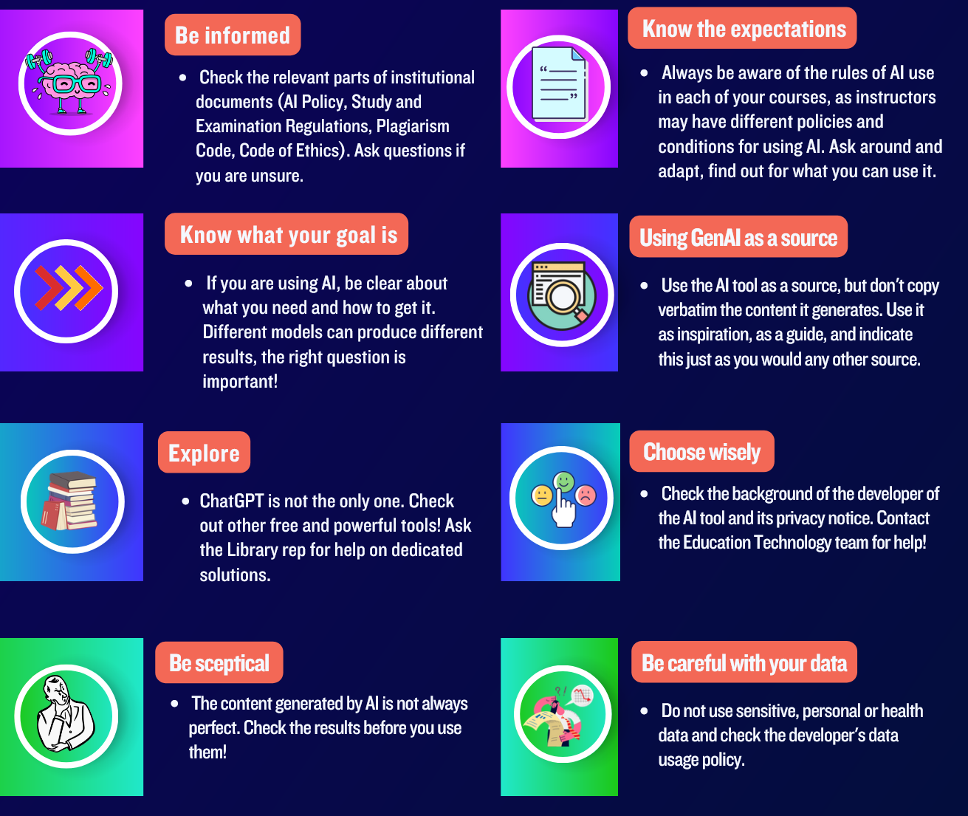
Always exercise Critical Thinking – be discerned about input/output

Slide 15
