Slide 1




Slide 2
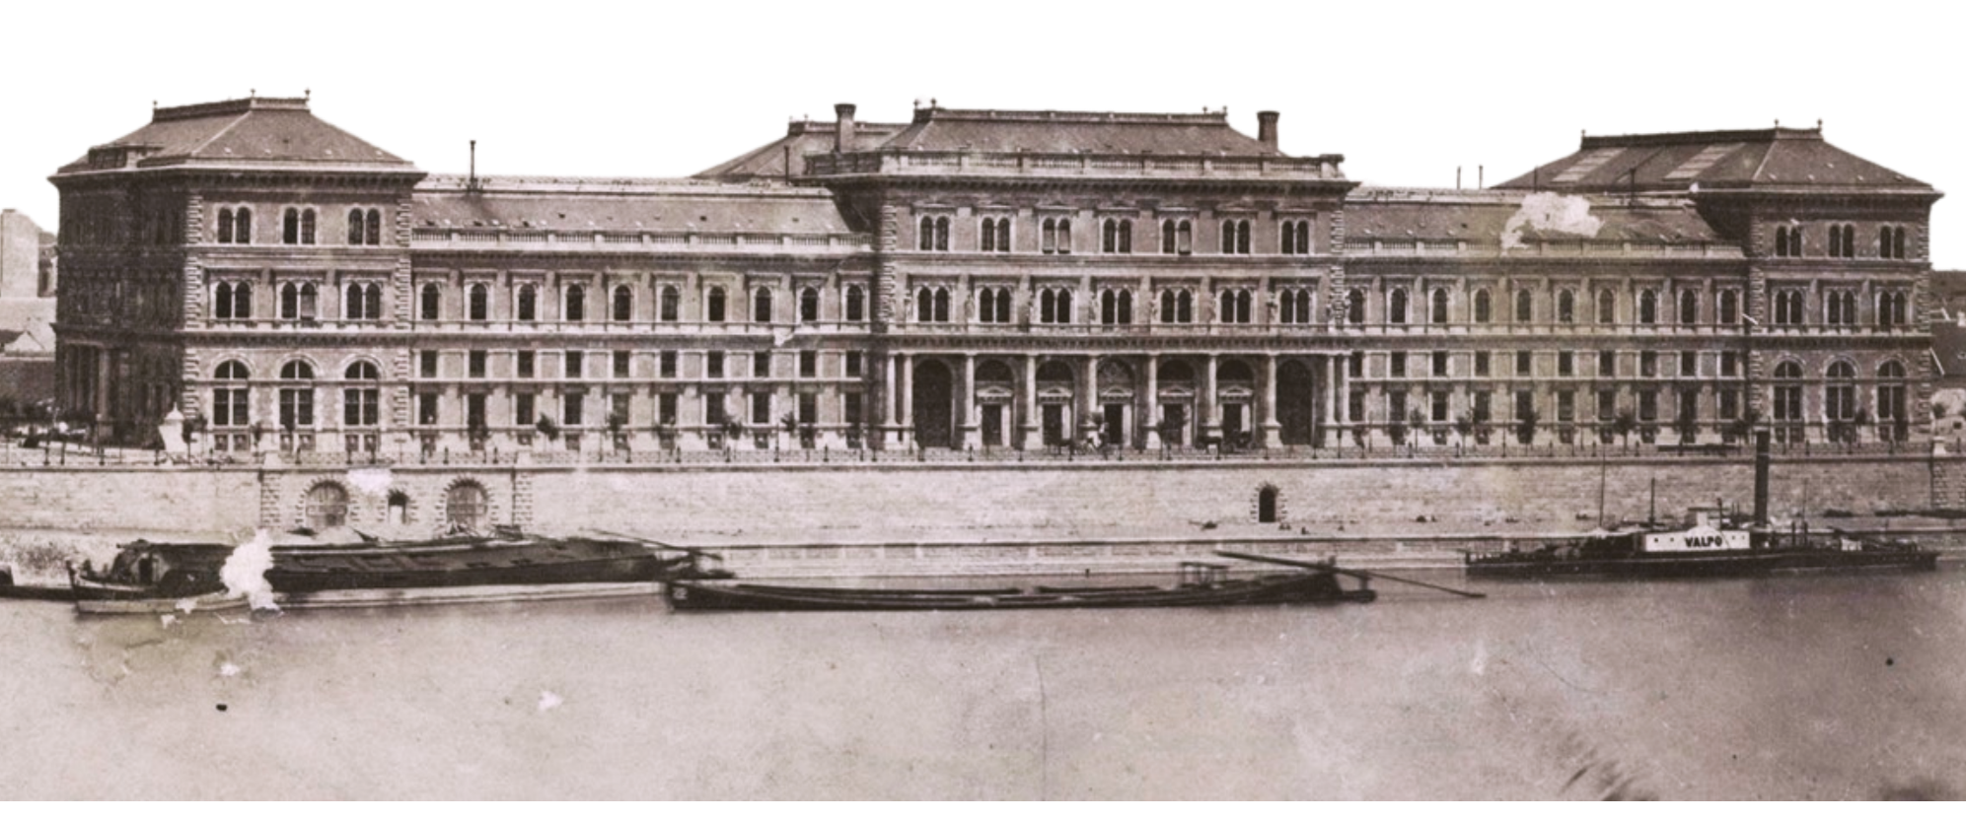
Since
1920
Notes:
Who we are in the past:​
​
Corvinus University of Budapest, established in 1920, is Hungary’s leading institution in the fields of economics and social sciences.​
​The university has a powerful impact on Hungarian science and the business sector.​
Since 1996, Corvinus has been a member of the CEMS alliance, a global network of leading business schools and companies.​
It has a strong tradition of student organisations, with over 40 active student groups.​ The first Hungarian student organisation, Rajk College, was founded in 1970.

Slide 3



Facilities
Danube

Slide 4
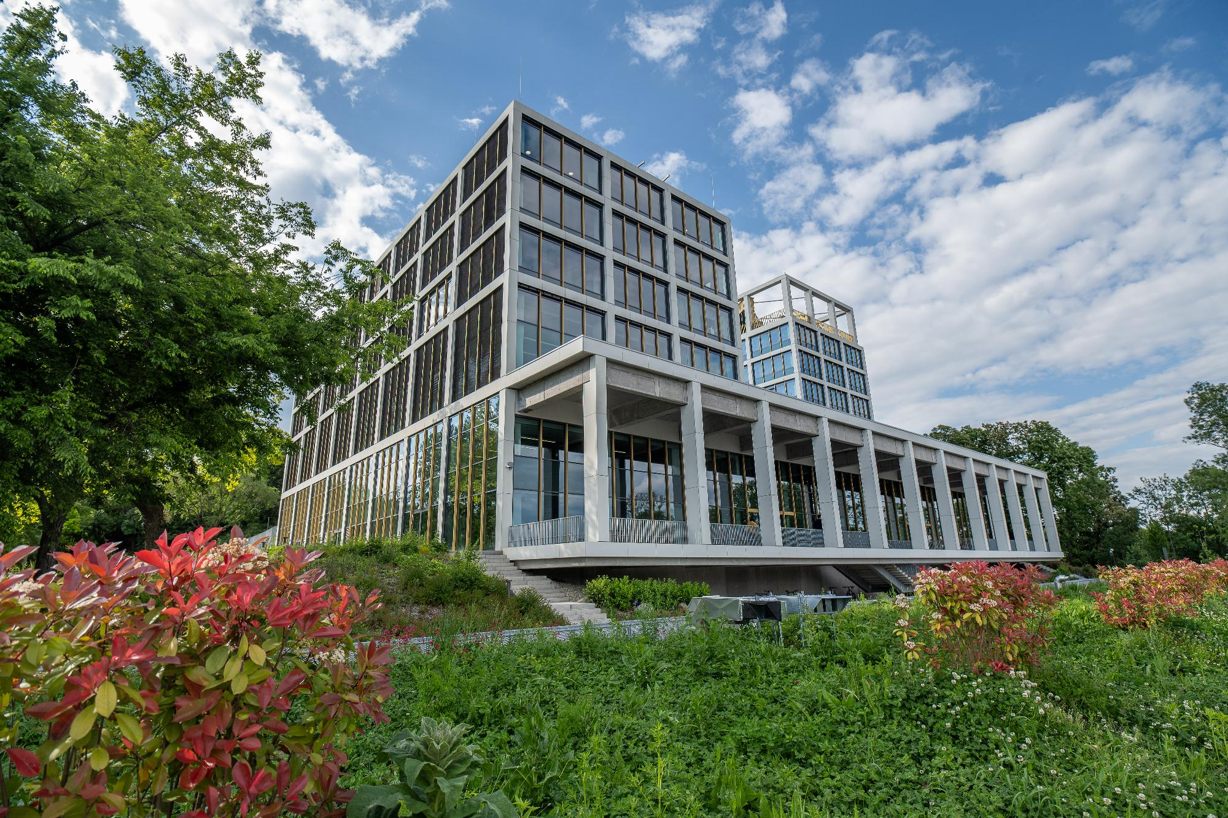
Facilities
Gellért

Slide 5

Corvinus
in numbers
8 500
470+
students
faculty
(47% female, 53%male,
19% international, 81% local)
39% female, 61% male
13% international, 87% local
270
4
4
475
17 000+
campuses
dorms
Q1, Q2 Publications
PhD students
of alumni club member​s

Slide 6


Most talented
students
Notes:
Corvinus has admitted over 2,300 new students, which is 25% more than last year.
The most talented applicants chose our university, and nearly a third of them are international, from almost 70 countries.
This clearly reflects the growing international appeal of our programmes.
Admitted students
- Hungary: +25%
- International: 2x
In the QS full-time MBA ranking, Corvinus University of Budapest was placed 54th in Europe and 151st–200th worldwide.
We are also the only institution in Hungary accredited by both the AACSB and the AMBA.
We are ranked first for the felvi score.

Slide 7





Programmes
Bachelor’s
programmes​
Master’s
programmes​
Postgraduate
programmes​
Executive
programmes​
5 programmes in English​
1 programme in Hungarian​
4 programmes
in both languages​
27 programmes in English
​​
3 programmes in Hungarian
MBA programme​
3 programmes in English
​​
20 programmes in Hungarian​​
1 programme in both languages​
Executive MBA programme
5 programmes in English
​​
28 programmes in Hungarian
Company specific programmes

Slide 8



Mission
Driven by curiosity, we thrive as a community
of research and learning in business, economics and social sciences, educating responsible thinkers, empowering forward-looking leaders.
Vision
As a historic national champion we
aim to be an internationally recognized university committed to address the challenges of our times.

Slide 9





Values
COLLABORATION
SYSTEMS
THINKING
EXCELLENCE
INTEGRITY
Notes:
Corvinus’ values
Collaboration: We actively work to build mutual trust and embrace shared goals as our own. We treat each other as partners and approach one another with empathy. We share knowledge and work together for individual and collective growth.
Systems Thinking: We approach challenges through open-minded and holistic thinking which involves both internal and external stakeholders. By addressing problems from multiple scientific perspectives, we deliver credible and impactful solutions. This mindset serves as a bridge between today’s realities and tomorrow’ s opportunities.
Excellence: We foster a culture of continuous improvement, self-reflection, and feedback. We set high international standards for ourselves, to deliver outstanding academic and scientific performance and services.
Integrity: We are a professional community driven by ethical conduct and authenticity. We are committed to transparent, consistent, and fair decision-making processes. Open and honest communication defines our interactions.

Slide 10






The
Bridge
Strategy
TRAM2
FLIGHT6
Operational excellence
INTERCITY
THE RING
Notes:
4 strategic pillars of the Bridge Strategy:
A multi-disciplinary business and economics university with real impact
+ Strong focus on AI and Sustainability
An international university (A university with global / international aspirations)
A university accessible for students with modest background (university open to talented students regardless of financial means)
A university striving for research excellenceThe solid foundation is Operational Excellence, which underlies every area of our activities.

Slide 11





Notes:
Accreditations – EFMD EMBA and EFMD BSc
Certifications/Commitments – BSIS, PRME
Affiliations – CFA, ACCA, PMI
Key Membership – CEMS
Rankings
Amongst the best European Business Schools as ranked by the Financial Times since 2005
Qs World Ranking by Subject 2024* - great position
Eduniversal Ranking 2024 - #1 in the region (Business and Management) and going for the 5 Palmes

Slide 12

Corporate
partners
Notes:
Corporate Relations
- Partnerships with companies and associations in research, innovation, production and sales
Connects students with business and institutional actors, offering mentoring and inspiration

Slide 13


