Slide 1
Study orientation at the beginning of the academic year
2025/26
1st - 4th September, 2025

Slide 2
Main Topics
1. Establishing your student status (conditions and acts without which you cannot establish your student status )
2. About courses, training programs
3. Termination of student status (what to look out for during your studies)
4. Corvinus Scholarship: Topics and rules for eligibility and non-eligibility (funded semesters and eligibility period)
5. Study, Neptun, Student ID and Financial administration

Slide 3
1. Establishing your student status
(conditions and acts without which you cannot establish your student status)

Slide 4
Conditions for the establishment of the student legal status
1. Enrollment:
  Compulsory document: Enrollment form –signed in 2 copies (unless you already completed the compulsory data confirmation/kötelező adategyeztető kérvény)
2. After completing the enrollment process, you have to set your semester status to 'active':
Where? In NEPTUN under Administration/Term registration menu
How? By selecting the semester 2025/26/1 --> active status --> Save
When? Between 1st September 2025– 12th September 2025 - see Academic calendar
If you fail to do so, your semester status will be set to passive (this cannot be reactivated later)
3. You have to register for at least one subject
  Except three Bachelor programmes: Business administration and management, Data science in business, International business economics (central registration for mandatory subjects only)
  Subject registration for students enrolled in all other study programs, including language courses and P.E. between 1st Sept 2025 10 AM (different days) – 7th Sept 2025 12 PM (subject registration guide here)

Slide 5
Course registration schedule
Action | Week | Course registration period | Course deregistration period
Course registration and deregistration (free of charge) | Week 1 | 01.09.2025 – 07.09.2025 | 01.09.2025 – 07.09.2025
Week 2: No course registration and deregistration during the Intensive/Project Week between 8th – 14th September 2025 – register for these subjects TODAY!!! between 16:00 - 23:59 (first activate!) |  |  | -
Additional course registration (only adding subjects!) (free of charge), BUT! deregistration only by payment via Neptun request* | Week 3 | 15.09.2025 – 21.09.2025 | Only by payment via Neptun request*
Late course registration only by payment via Neptun request* | Week 4 | 22.09.2025 - 28.09.2025 | ---
B102 - Késedelmes tárgyfelvételre vonatkozó kérelem / B102 - Late course registration request: 22.09.2025 10:00 – 28.09.2025 23:59
B201 - Késedelmes tárgyleadásra vonatkozó kérelem / B201 - Late course deregistration request: 15.09.2025 10:00 – 21.09.2025 23:59

Slide 6
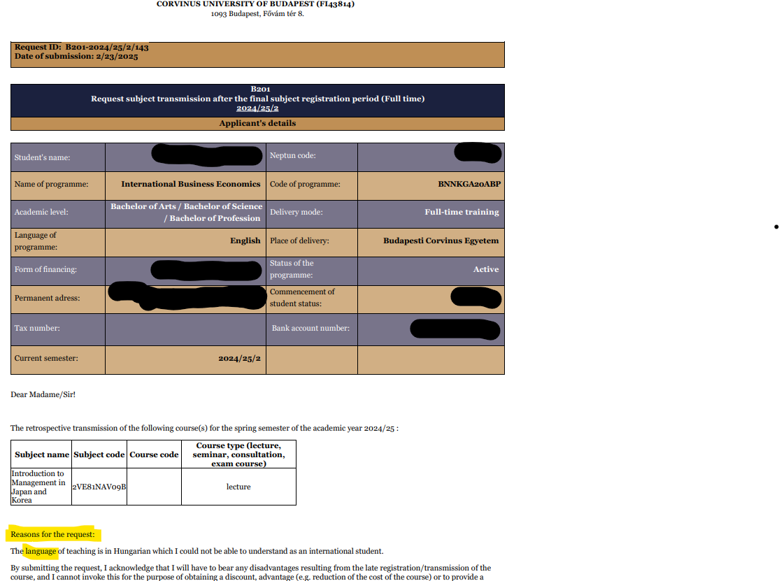

Slide 7
Course registration: potential problems and their solutions
(potential) problem
Cannot find the course in Neptun
  The course will not be offered OR
  You are trying to register for it in the wrong semester
  No more places at the course
Error message indication clashing courses
  Two practices in fact are not allowed to clash
  You can only have one clash (lecture/lecture or lecture/practice) – maybe it is your 2nd clash?
An unpaid debt blocks me from course registration
Maximum number of credits/semester: 42 credits
solution
Contact the professor!
  (https://www.uni-corvinus.hu/main-page/about-the-university/departments/?lang=en)
Sorry, you must choose a different course☹!
Under Finances/Payments you can see and pay your overdue debts
Please don't, we want you happy and healthy. Leave time for yourself. :)

Slide 8
2. About courses, training programs

Slide 9
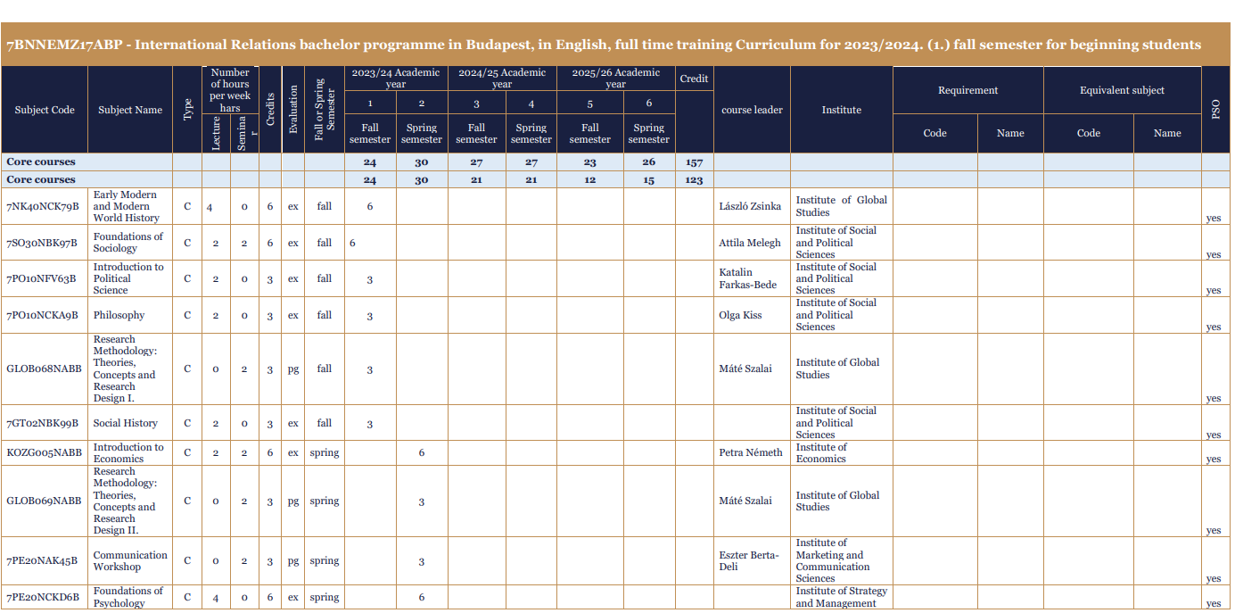
About courses, training programs
Where to find it on the website?
For Students → International and Administrative Student Services → Programs, Curriculum
Example:
Bachelor programmes

Slide 10
3. Termination of student status
(what to look out for during your studies)

Slide 11
Cases of termination of student status– SER rules
Cases of cessation and termination of the student status 39.§
Termination of student status due to payment arrears 40.§
Termination of student status due to a disciplinary offence 41.§
Unilateral termination of student status 42.§
  (1) The student status of a student who fails to fulfil the obligations relating to progress in studies laid down in the SER shall be terminated, it being understood that:
    a student who commenced the first year of his/her studies after the 2022/2023 academic year has exhausted the possibility to register for a given subject twice, or in the case of an equity decision three times
    a student who commenced his or her first year in the 2020/2021 academic year or later does not reach a minimum (cumulative) weighted academic performance of 2.5, except in the first active semester;
    a student who commenced his or her first year in the 2020/2021 academic year or later, fails to earn at least 15 credits in his or her first two consecutive active semesters,…;
    under the admission procedure for master programmes, the student fails to earn the missing credits that are to be completed on a mandatory basis simultaneously with the programme within the time limit specified in the decision on credit recognition and the curriculum;
    the number of failed exams in the same curriculum unit has reached six;
    the number of failed make-up Rigorosum exams has reached four;
    the student has exhausted the three attempts to pass the comprehensive examination that concludes the given subspecialisation/specialisation/study programme in the given programme
    the student fails to fulfil his or her obligation to register for subjects after signing in, and it is not possible to suspend his/ her student status;
    the student exceeds the maximum period of studies available for completing his/her studies.
    a student who commenced his or her first year in the 2016/2017 academic year or later fails to complete at least 50% of the credits specified as a mandatory requirement for obtaining a diploma as set out in the programme and outcome requirements during the active semesters corresponding to the programme duration of the given study programme.
  (2) The University shall unilaterally terminate the student status of a student who:
  fails to register for the next semester for three times in a row, except for the case specified in subparagraph a) of paragraph (1) of Section 35;
  the student does not resume his/her studies after the interruption of his/her student status and the conditions for further suspension are not met.

Slide 12
Duration of programme, period of studies (SER 13.§)
(5) The maximum period of studies shall be:
  In the case of a programme with a duration of 2 semesters, a maximum of 8 semesters, with the number of active semesters not exceeding a total of 4 semesters;
  In the case of a programme with a duration of 3 semesters, a maximum of 9 semesters, with the number of active semesters not exceeding a total of 6 semesters;
  In the case of a programme with a duration of 4 semesters, a maximum of 12 semesters, with the number of active semesters not exceeding a total of 8 semesters;
  In the case of a programme with a duration of 6 semesters, a maximum of 14 semesters, with the number of active semesters not exceeding a total of 10 semesters;
  In the case of a programme with a duration of 7 and 8 semesters, a maximum of 16 semesters, with the number of active semesters not exceeding a total of 12 semesters;
  In the case of a programme with a duration of 10 semesters, a maximum of 18 semesters, with the number of active semesters not exceeding a total of 14 semesters;
  in the case of a 4-semester Master programme, if the University decides to reduce the duration of the course to 2 semesters during the validation procedure (i.e. it states that the student's period of studies is 2 semesters), the maximum period of studies shall be determined as set out in subparagraph (a) (hereinafter the “maximum period of studies”).
(6) In the event that the student's period of studies exceeds the maximum period of studies, the student's student status must be terminated according to the SER.
(7) If the student establishes a student status at the University based on a transfer, or changes his/her programme within the institution, the programme duration and the period of studies shall be calculated as follows:
  the programme duration is identical with the period of studies of the given programme, since the programme duration restarts with the transfer,
  the maximum period of studies is identical with the maximum period of studies of the given study programme, since the maximum period of studies restarts with the transfer or with the change of programme within the institution.

Slide 13
4. Corvinus Scholarship
Themes and rules for eligibility and non-eligibility
(funded semesters and eligibility period)

Slide 14
Main rules of Corvinus Scholarship
Regulation on Student Fees and Benefits (26.§ in particular)
(The Regulation can be downloaded from here)
Main topics (see next slide):
Duration of the training program
Number of funded semesters
Eligibility period
Who is eligible? (Main rules)
Students admitted through the central admission procedure –in case of a program advertising Corvinus Scholarship
The number of credits in the last two ACTIVE semesters: a minimum of 46 credits
The average of the GPA of the last two ACTIVE semesters: min. 3,80

Slide 15
Main rules of Corvinus Scholarship
Main themes:
Duration of the training program – TOR (according to Training Outcome Requirements)
Semester Abroad: need to register for ”Semester Abroad” course!
Number of funded semesters
Bachelor, Master and two-cycle and single cycle programs: TOR
In case of students registered at the Disability Committee, Bachelor and Master programs: + 1 semester, single cycle training program: +2 semesters
BUT: funding period can be extended by submitting a REQUEST(!)
  Due to participation in an exchange programme abroad
  Can be submitted till last day of the preceding semester
  5% of the minimum wage
Eligibility period
Bachelor and Master programs: TOR + 1 semester
Single cycle training program: TOR + 2 semesters
students registered at the Disability Committee:
TOR*2
BUT: funding period can be extended by submitting a REQUEST(!)
  Due to participation in a foreign exchange program abroad or illness or childbirth
  Can be submitted till last day of the preceding semester
  5% of the minimum wage

Slide 16
Main rules of Corvinus Scholarship
Repayment obligation of the scholarship in the following cases:
The student does not obtain a diploma on a given academic level during TOR * 2 (within twice the programme duration),
The student declares the termination of his/her student status
Opportunities for repayment facilitation
By submitting an Equity request: requesting for payment in installments
In particulary justifiable circumstances: the possibility to reduce payment obligation
In case of establishing a new student status again on the same training program
No opportunity for receiving Corvinus Scholarship if the student's previous student status (on the same academic level) was terminated through his/her own fault
In case of parallel training
Only one training program at a time can be funded by Corvinus Scholarship
More information on our website: https://www.uni-corvinus.hu/main-page/life-at-corvinus/scholarship/corvinus-scholarship/?lang=en

Slide 17
5. Study, Neptun, Student ID and Financial administration

Slide 18

Location of your study system and your finances: NEPTUN
Enrollment, subject registration/deregistration, exam registration, grades,
Request submission opportunities
Student requests (general)→ Administration/Requests/ „request fill” menu
  Subjects → Subject related requests
  Exam related → Exams/Taken exams
  Financial item related → Finances/Payment
  Finances
  Neptun/Finances/Scholarship, payouts
  Neptun/Finances/Payment
All official questions will be answered HERE!
!
!
Check your Neptun messages regularly
(do not just read them as e-mails!)
Student ID

Slide 19
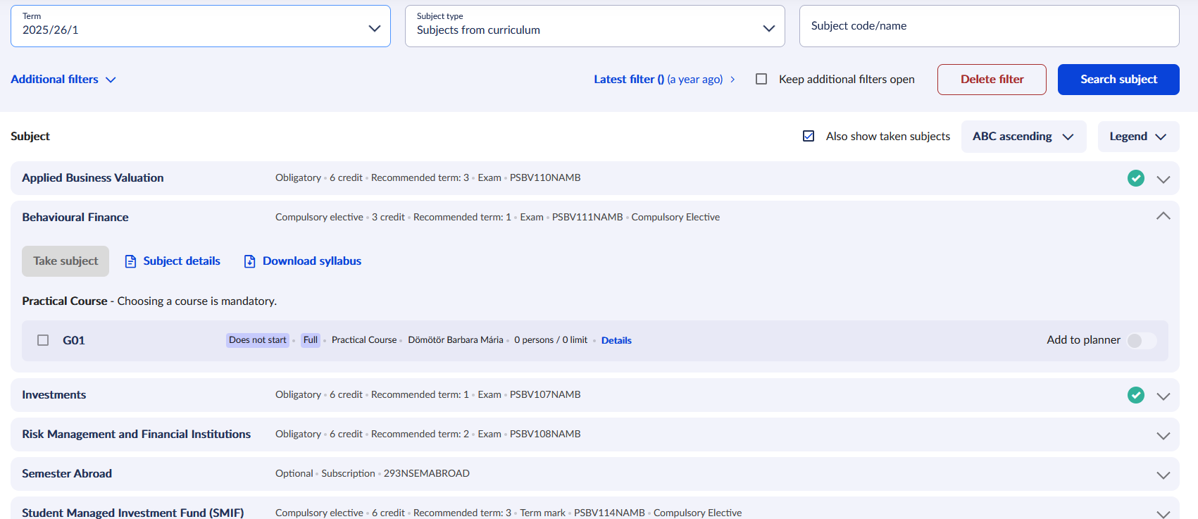
Registration for courses

Slide 20
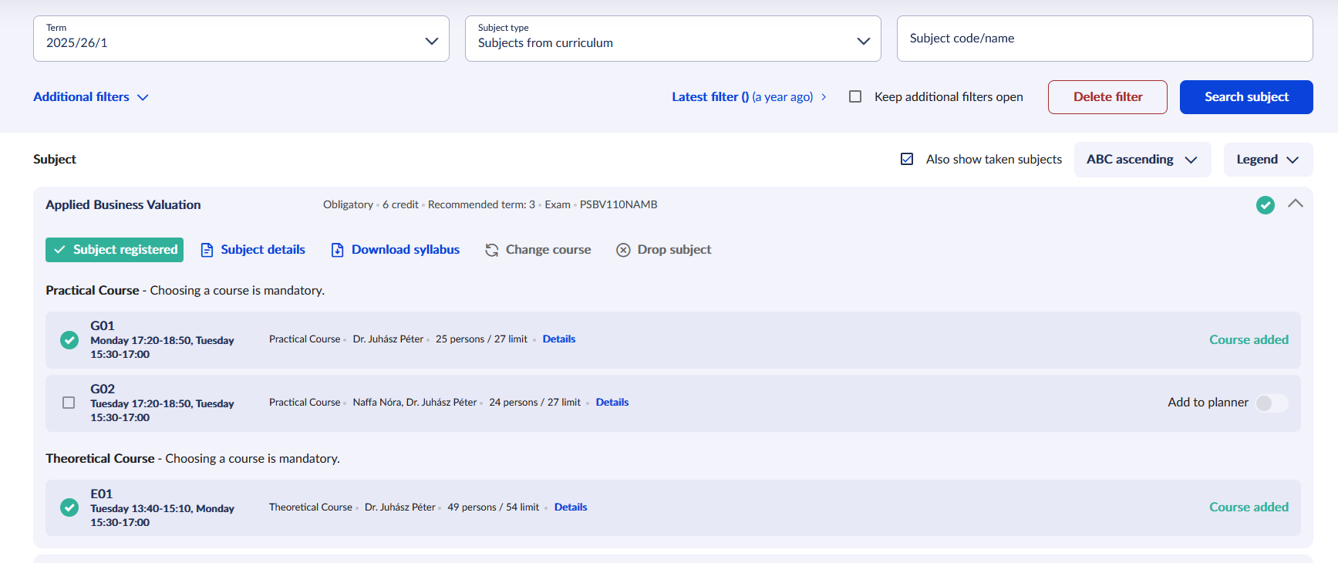
Registration for courses
If the course is full, email the department/institute administrator.

Slide 21
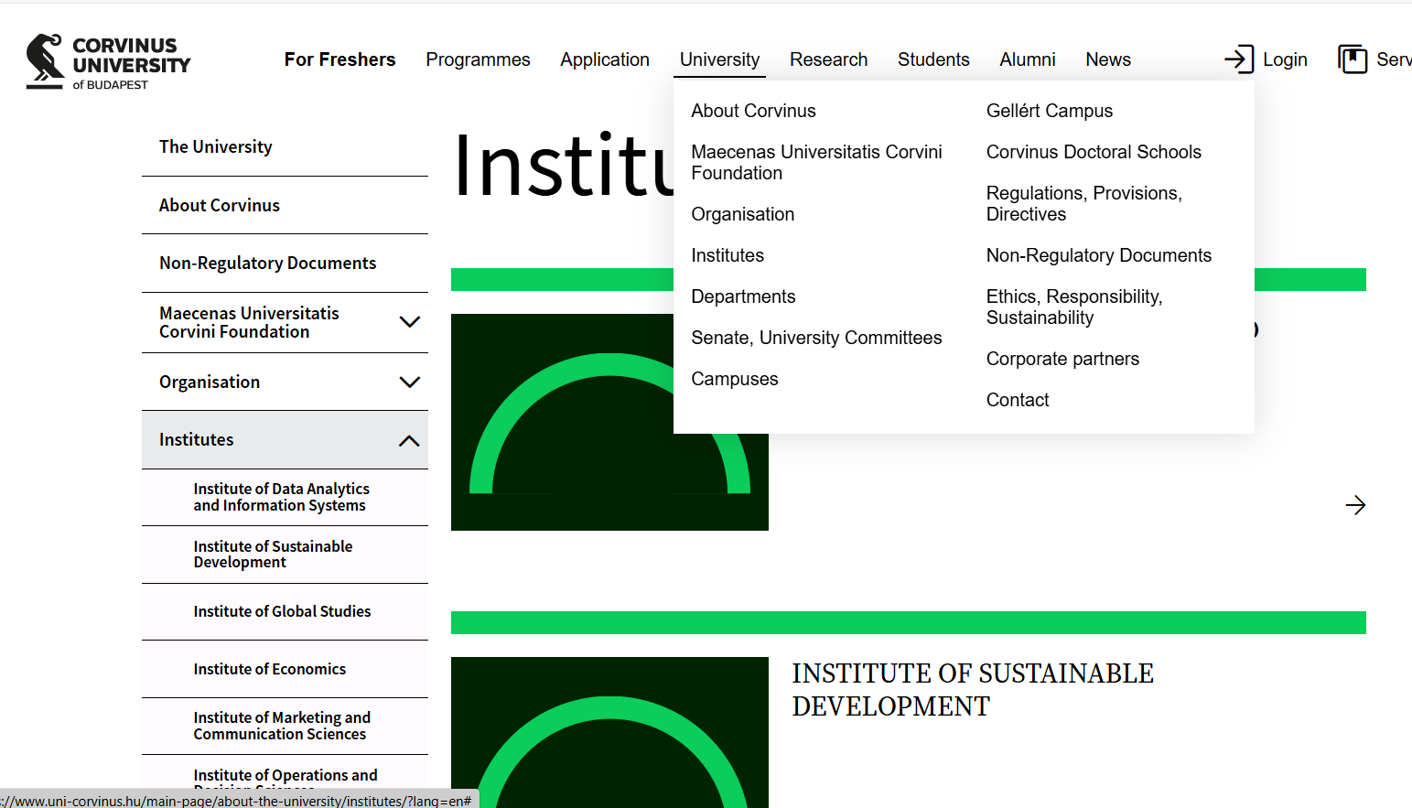

Slide 22
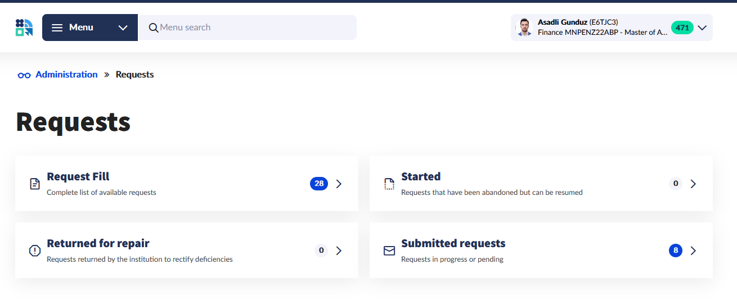

Slide 24
Managing your finances
In the Neptun system
  Items that you have to pay in: Neptun/Finances/Payment
  Payment options – priority SimplePay (e.g.transfer comment: NK- NEPTUN-reason for payment)
    One transaction may be used to settle multiple items.
    The student must have an email address registered in Neptun.
    Any card suitable for online payments can be used without installing the Simple app.
    The status of the item becomes settled immediately.
    The student receives an email if the settlement is successful.
    If the settlement is not successful, the student may make inquiries at the SimplePay customer service referencing the SimplePay ID.
    Payout items (eg. scholarships): Neptun/Finances/Scholarship, payouts
You can find information on the amount of university fees and tuition fees in the Regulation on Student Fees and Benefits or on the Do it online platform with the Financial Team (finances, payments, scholarships)

Slide 25

Study administration: in person and on the Do it online! platform
Yes
If you are looking for easy, quick anytime information:
Do it online
Search by topic and read the article
Did you find the answer to your question?
No
Start a case
(it is like writing an email)
If you need assistance in person: go to the Student Services Area
(physical ID required)
Opening hours: Monday-Thursday
between 9 a.m. and 4 p.m.
Building E 1st Floor
If your case is unique or complex
Write to us in the Do it online system
(Choose the appropriate topic according to your issue and you can expect a reply in 2 working days)

Slide 26
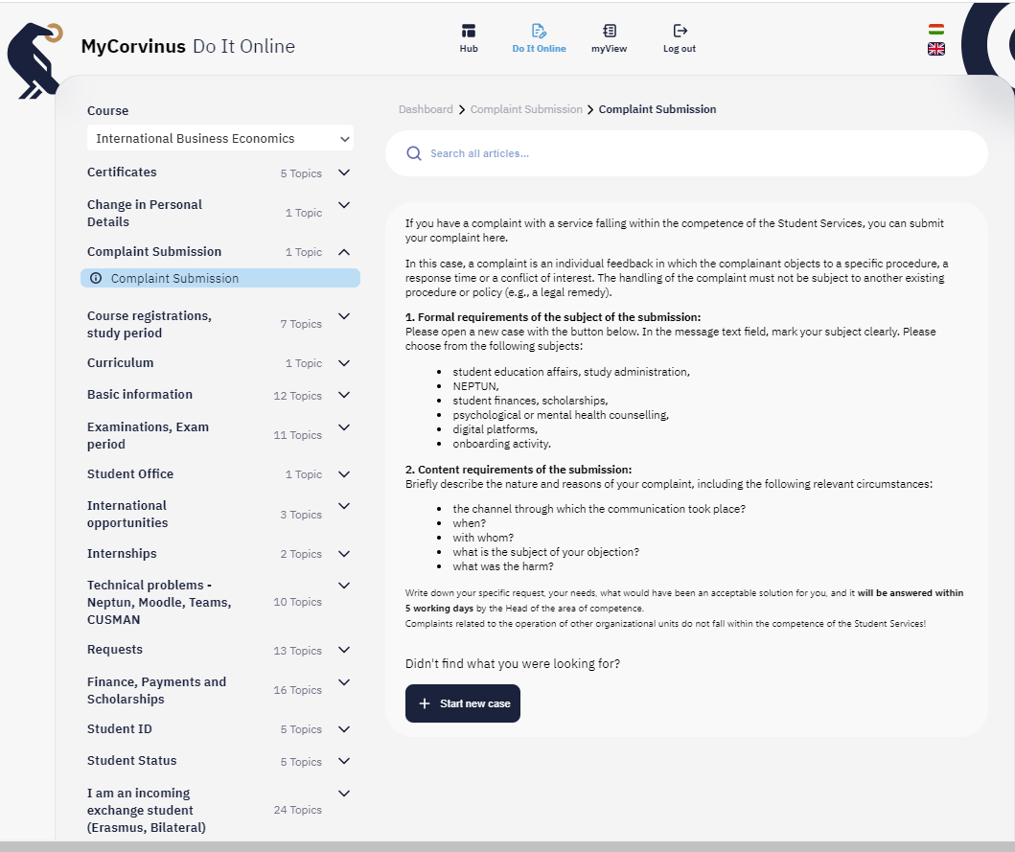
Do it online topic list

Slide 27
What next?
Schedule

Slide 28
Thank you for your attention!

