Slide 1
International Opportunities
2025/2026 academic year
Pannónia Scholarship, Double Degree, CEEPUS Programmes
Application period: 20 January 2025 – 03 February 2025 (3 pm)

Slide 2
Why should I study abroad?
Self-confidence
Language knowledge
Experience of a lifetime
Foreign language presentation skills
World view
Money management
Building connections
Advantage in looking for a job
Conquering fears
Adventure
Professional experience
Special courses
International university / work experience

Slide 3
International opportunities
Long-term mobility (one or two semester or trimester): 2 – 6 months
Internship abroad: 2 -6 months
Double degree programmes
Short-term mobility: 1 week – 1 month
CEMS programme (CEMS Master’s in International Management)
DSG
QTEM
CEEPUS

Slide 4

Long-term mobility
Over 200 quality partner universities
Partners within and outside of Europe
About 500-550 incoming and outgoing students
Application period in January-February
Conditions for short-term mobility opportunities are under development
Between 350-400k HUF scholarship (depending on country)

Slide 5

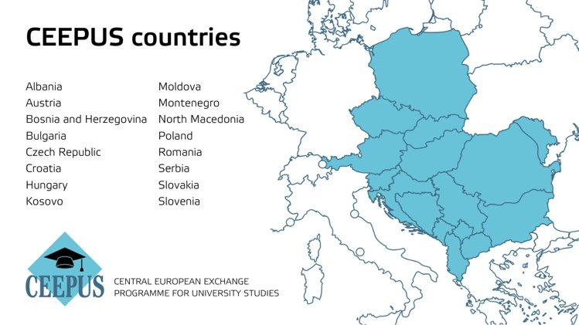
The CEEPUS scholarship programme involves 16 countries from Central and Eastern Europe and the Western Balkans.
Corvinus currently has 5 CEEPUS networks
Open to: undergraduate, master’s and PhD students
Activity: attendance, completion and crediting of courses is compulsory during the stay
As each country provides grants to its incoming fellows, the grant amounts vary from country to country
Duration: 1 semester or trimester, 3 - 5 months
You can apply within a network or as a freemover
and the Western Balkans.

Slide 6

Double Degree Programmes
Two equivalent diplomas in the same or nearly the same programme duration
Bilateral agreement between institutions (4-5 students per year)
Pre-established curriculum (automatic course recognition)
1, 2 or 3 three semesters at the partner university (depends on the programme)
Only Corvinus tuition to be paid during semesters abroad. Scholarship students do not pay tuition during their studies abroad either
Option to apply for Pannónia Scholarship funding
Application to Porto has already closed, other partners still available
More information at www.uni-corvinus.hu under Programmes > International Opportunities > Double Degree
Notes:
Based on a formal agreement. We have a contract that states the requirements of the home university and the host university. You have to fulfil both universities requirements: example, in France Thesis defence but at corvinus ……

Slide 7




Double Degree Programmes
Partner universities | Country | Partner University Programme | Language of instruction | Corvinus programme | Training level
Kedge Business School | France | BSc in Management |  | Business and management (English) | Bachelor’s
University of Passau | Germany | MSc in Business Administration |  | Marketing (English) Management and leadership (Hungarian) | Master’s
Université de Liége | Belgium | MSc in Economics |  | International economy and business (English) | Master’s
Kedge Business School | France | MSc in Marketing |  | Marketing (English) | Master’s
University of Palermo | Italy | MSc in Public Management |  | Public policy and management (English) | Master’s
Catolica Porto Business School | Portugal | MSc in Management |  | Marketing (English) | Master’s

Slide 8

Internship abroad
Available for all students
Travel abroad possible after two completed semesters
International semester can also be an internship
Can also be done during summer or educational break
Possibility for internship after completing academic requirements
CV: international work experience has a sway on the job market
Continuous application

Slide 9

Scholarship options
Pannónia Scholarship Programme
Maecenas Universitatis Corvini Foundation
Useful websites:
    pannoniaosztondij.hu
    International opportunities on the Corvinus website

Slide 10
Application
Application platform: Neptun
For next academic year
Partners list on the website
Dates: 2025.01.20 – 02.03.
Results: 2025.02.24.
Scoring: 70% academic performance, 30% extracurricular activities

Slide 11
Minimum requirements
Min 3,00 GPA
CEFR B2 language certificate in the language of instruction
6 universities can be chosen during application
At least 21 credits must be completed during mobility (30 for International Business)
Credit recognition after arriving back home (not automatic)

Slide 12
Getting ready to apply
Plan wisely:
  Country - livelihood, entry rules, personal security
  Partner university – only your own field of studies!
  Language of instruction – have a B2 language certificate + check if the partner requires an additional language certificate
  List of courses - relevant to your curriculum
  HÖK and ESN - practical questions can be addressed to the student organisations
Testimonials: on the website
  Accommodation options
  Local transport
  Livelihoods
  Leisure, cultural activities, local activities in addition to studies

Slide 13
If you have questions or comments about the application process, please contact:
Do It Online
International opportunities

Slide 14


DSG Corvinus
... wenn es Ziel ist, sich von der Masse abzuheben

Slide 15
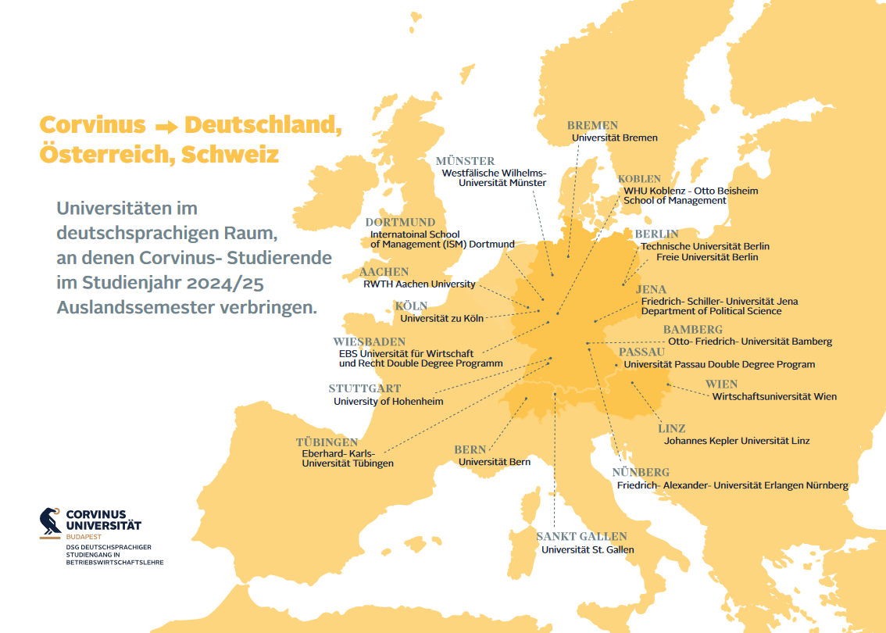

Slide 16
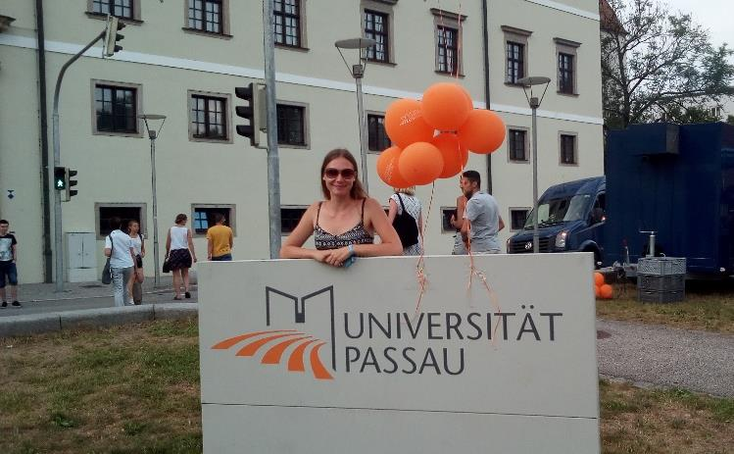
Auslandssemester im BA-Studium
Auslandssemester in der DACH-Region (deutschsprachige Länder)
In allen BSc-Studiengängen: ein Semester
Kurse in Deutsch und/oder Englisch
Deutschsprachige Kurse werden auf das DSG-Zertifikat angerechnet
Finanzierung: durch Pannonia-Stipendium
BSc-Studiengang Business and Management: Doubledegree an der EBS Universität (bei Wiesbaden)
Das DSG-Programm bereitet die Corvinus-Studenten
auf ein erfolgreiches Auslandssemester in der DACH-Region vor.

Slide 17

Kooperation mit der Universität Passau
im Rahmen des Masterstudiengangs
Doppelter Master-Abschluss: 2 Semester in Budapest - 2 Semester in Passau
Kurse mit Professoren der Universität Passau und der Corvinus Universität
Diplom in Englisch oder Deutsch
DAAD- und Pannonia-Stipendien für ein Auslandsjahr
Voraussetzung: mindestens 10 ECTS DSG-Kurse
Abschlüsse: Master in Business Administration der Universität Passau, bzw:
MSc in Management and Leadership oder
MSc in Supply Chain Management oder
MSc in Marketing der Corvinus Universität Budapest

Slide 18
Ansprechpartner und weitere Informationen
DSG-Direktorin: Dr. Loretta Huszák
loretta.huszak@uni-corvinus.hu
DSG-Koordinatorin: Gabriella Virág
gabriella.virag@uni-corvinus.hu, dsg@uni-corvinus.hu
E.116 DSG-Büro
Instagram: @dsg_corvinus Virág
Facebook: /DSGCorvinus
Website: https://www.uni-corvinus.hu/dsg
LinkedIn: https://www.linkedin.com/in/dsgcorvinus/
Stipendien (u.a.):
Pannonia-Stipendienprogramm - https://pannoniaosztondij.hu/
Deutscher Akademischer Austauschdienst (DAAD) - https://www.daad-hungary.org/hu/

Slide 19
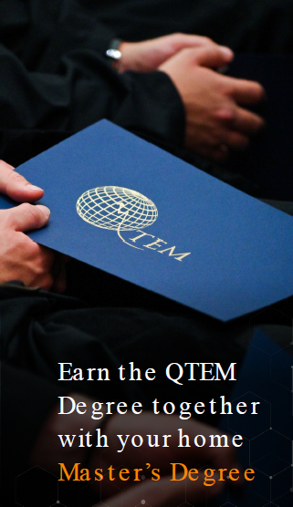

Quantitative
Techniques for
Economics and
Management

Slide 20
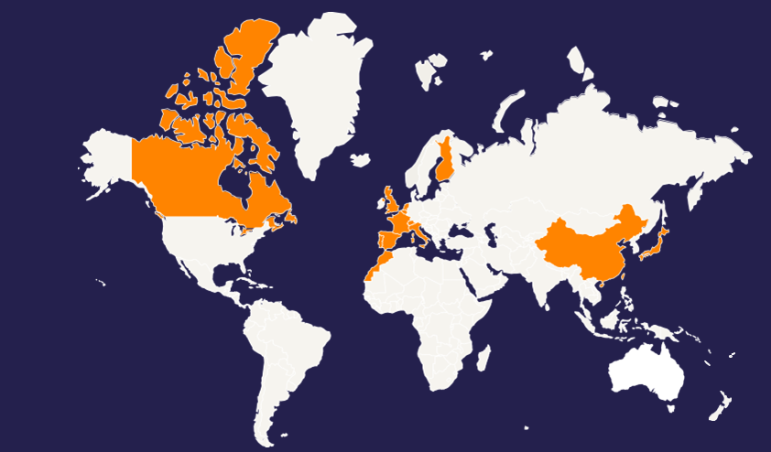
QTEM is a global network involving more than 20 outstanding ranked business schools and universities worldwide
University of Exeter Business School (UK)
BI Norwegian Business School (Norway)
HEC Montréal (Canada)
Pompeu Fabra University (Spain)
Waseda University (Japan)
Université Paris-Dauphine (France)
Goethe-Universität Frankfurt (Germany)
Universiteit van Amsterdam (Netherlands)
Hanken School of Economics (Finland)
HEC Lausanne (Switzerland)
Zhejiang University (China)
LUISS Guido Carli (Italy)
Corvinus University (Hungary)
Universidade do Porto (Portugal)
Rabat Business School (Morocco)
Technische Universität München (Germany)
16
countries
4
continents

Slide 21

Students from quantitative master programs (50% quant. courses)
Open to both national and international students!
Corvinus University of Budapest
Business Informatics
Economic Analysis
Economic and Financial Mathematics
Finance
Scholarship available through the Pannonia Program

Slide 22

QTEM offers an exeptional opportunity to enhance 3 main pillars:
Quantitative
and analytical skills
Access to quantitative courses abroad through academic partners
(~ 2000 courses, ~ 90 courses per partner)
International
Experience
Spend one (or two) semester abroad
Professional
Experience
Mandatory minimum 240-hour internship at a corporate partner at home or abroad
Two online courses (data science and digital leadership course)
+
QTEM Data Challenge (project work, international team)

Slide 23
Requirements and application timeline
December 1, 2024 – January 6, 2025
Application period
2 calls per year!
Next exchange:
September 2025
Student from quantitative master programs
GMAT score of ≥ 605 (555 < 605 can be considered)
Proof of English knowledge
Motivation letter
Completed oral interview (in-house)
Application period | December 1, 2024 - January 6, 2025
Interviews | January 13 – 24, 2025
Confirmation of exchange destinations | March 1, 2025
GMAT score submission deadline | May 1, 2025

Slide 24
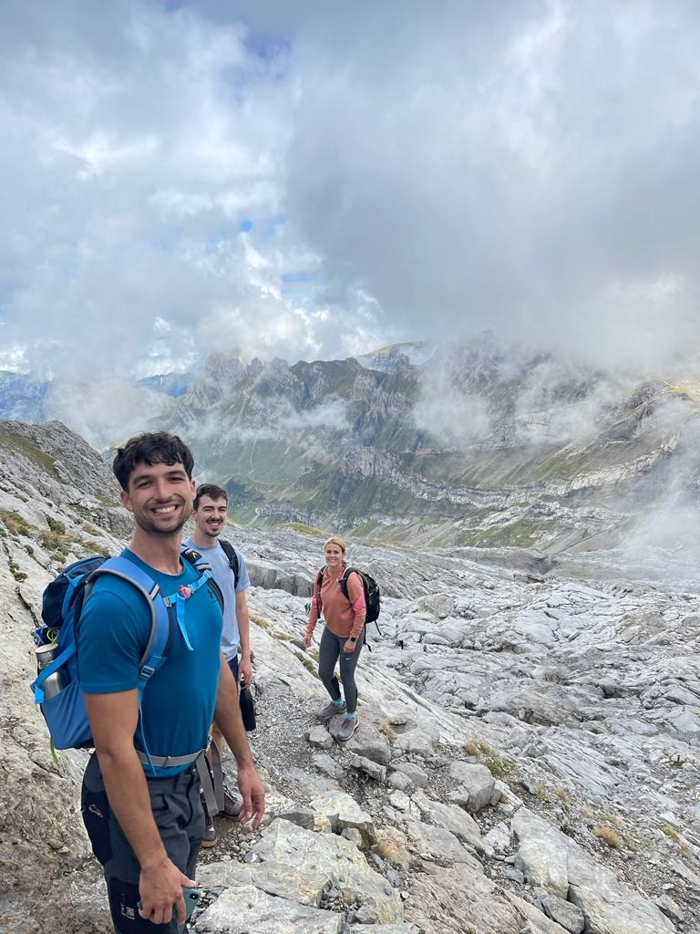
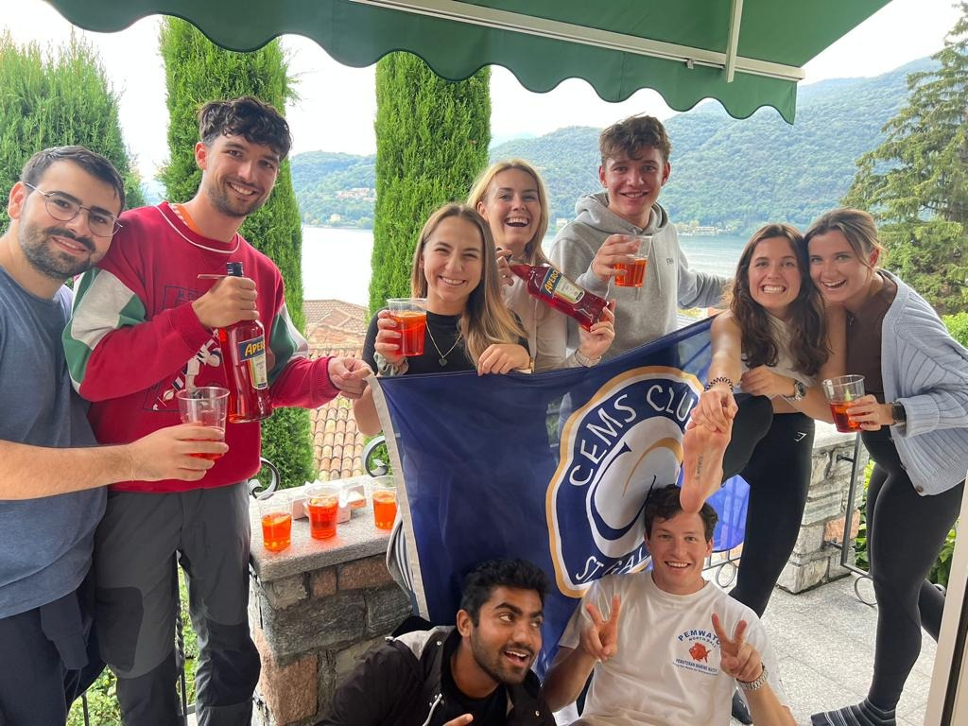
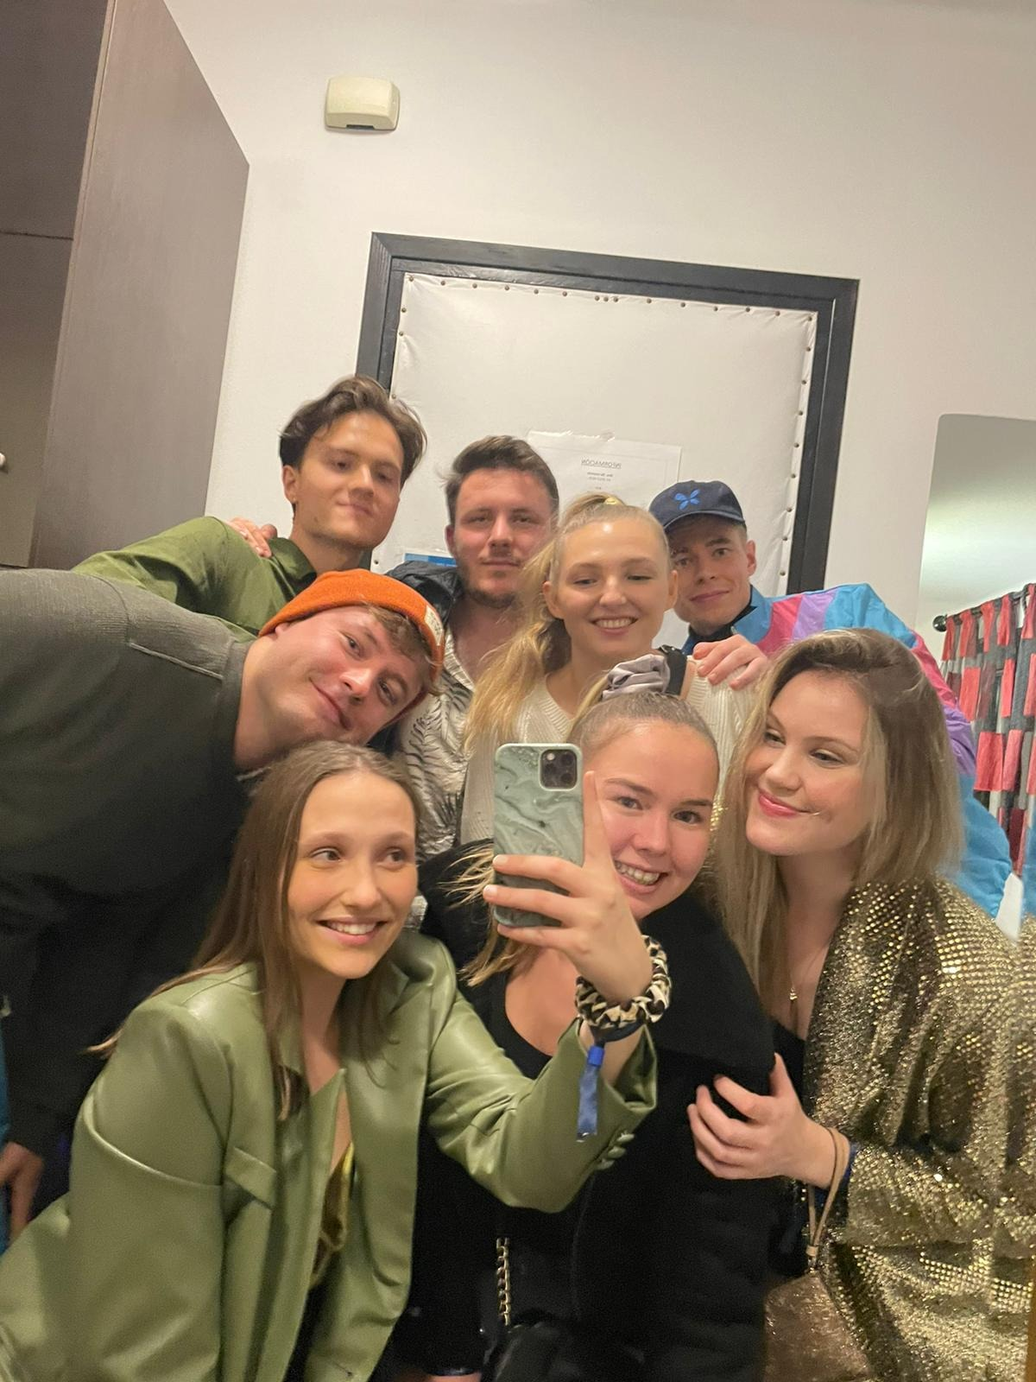



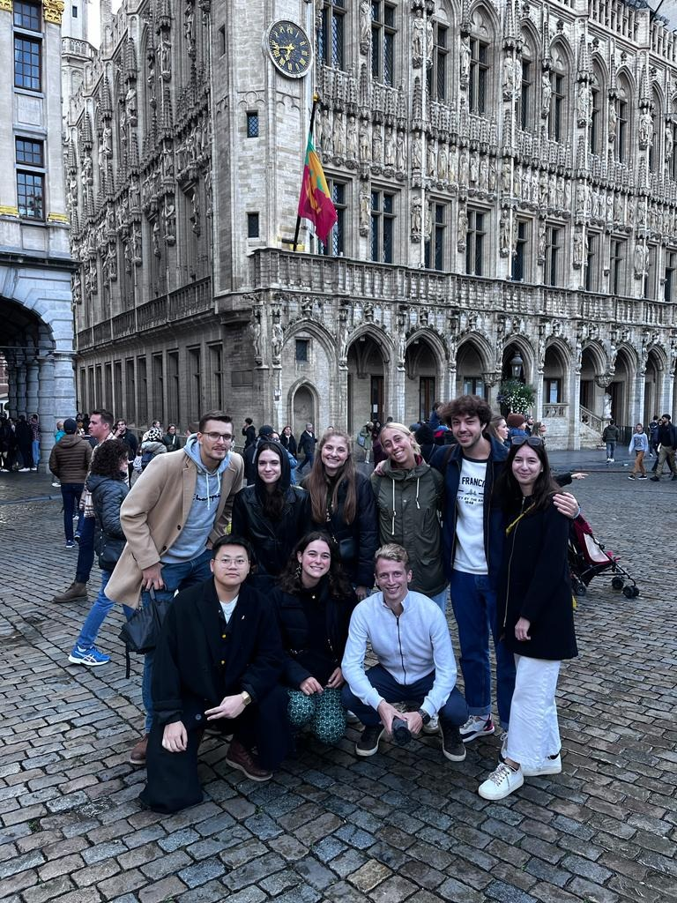

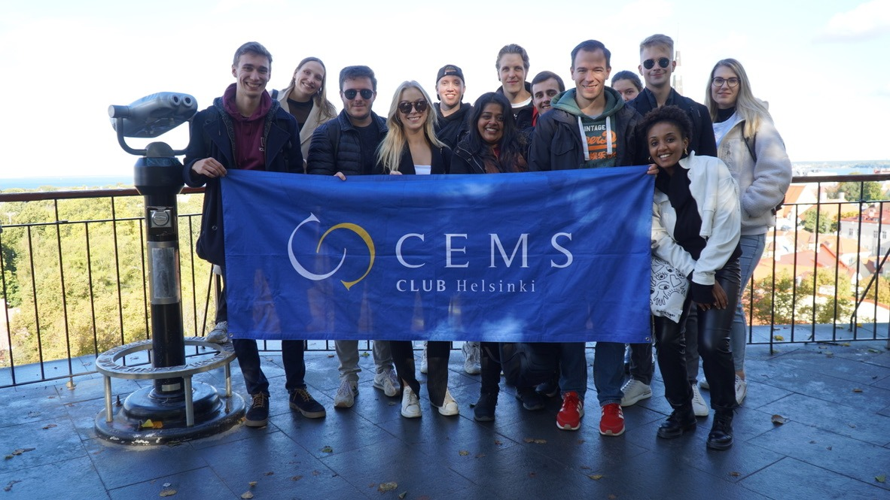

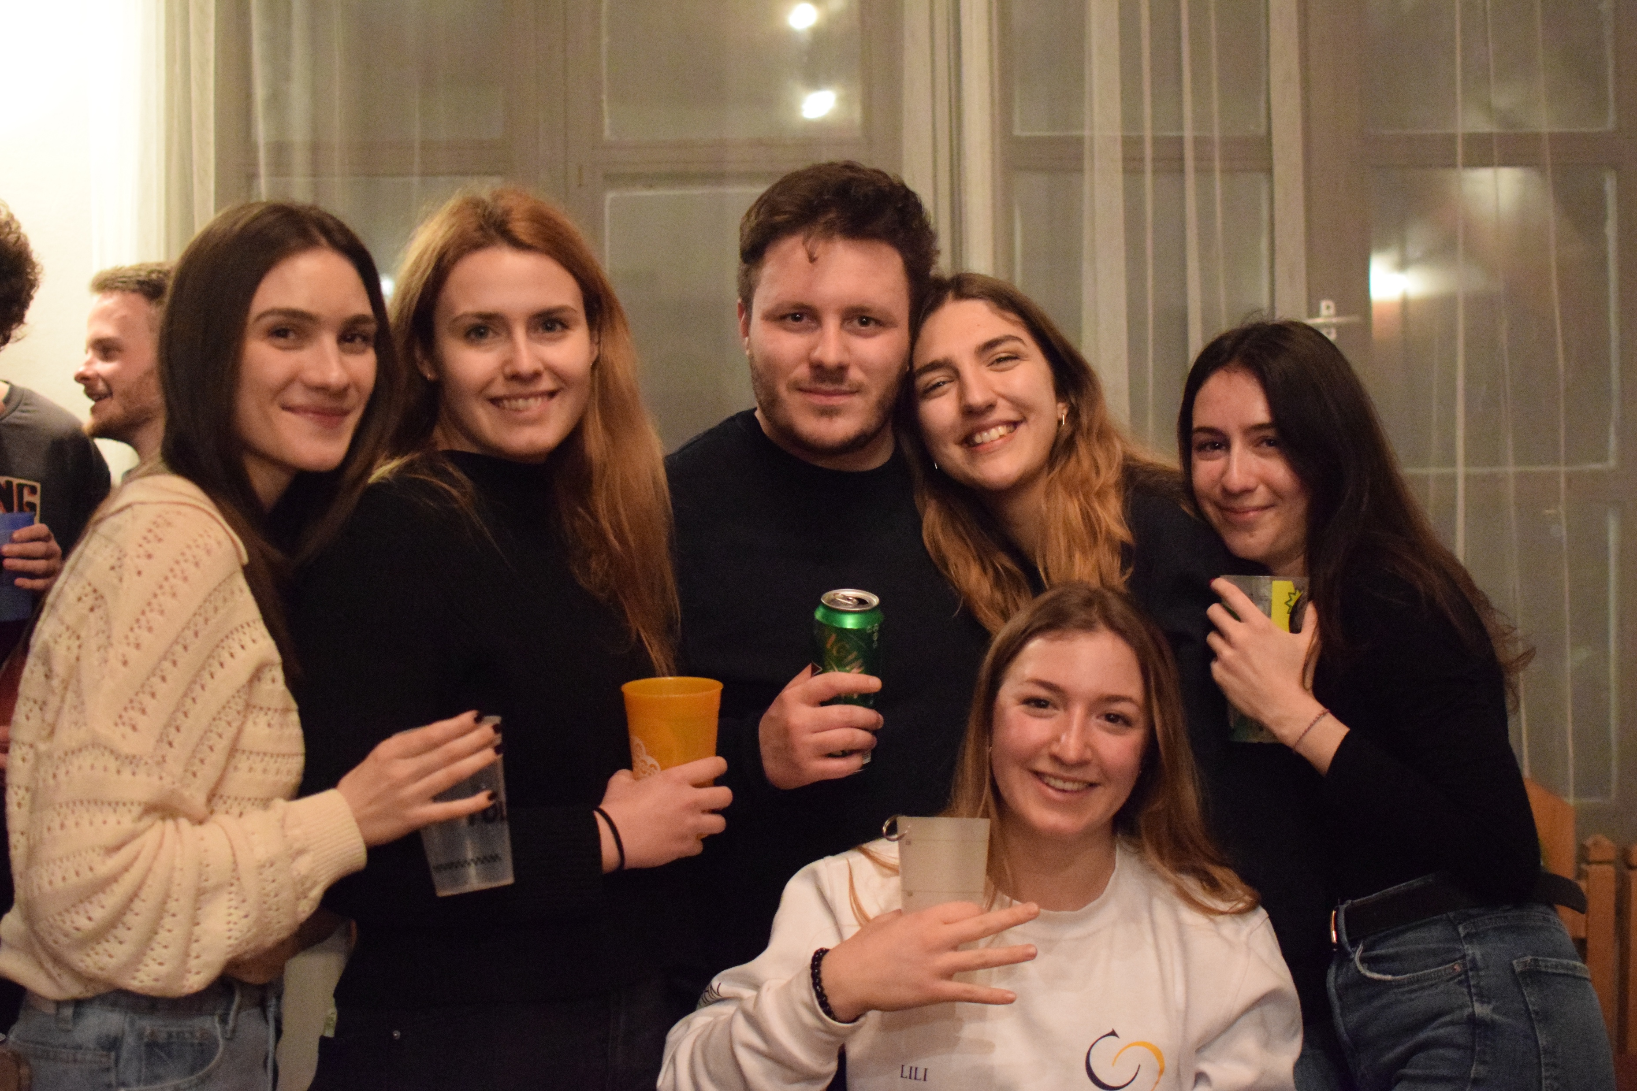
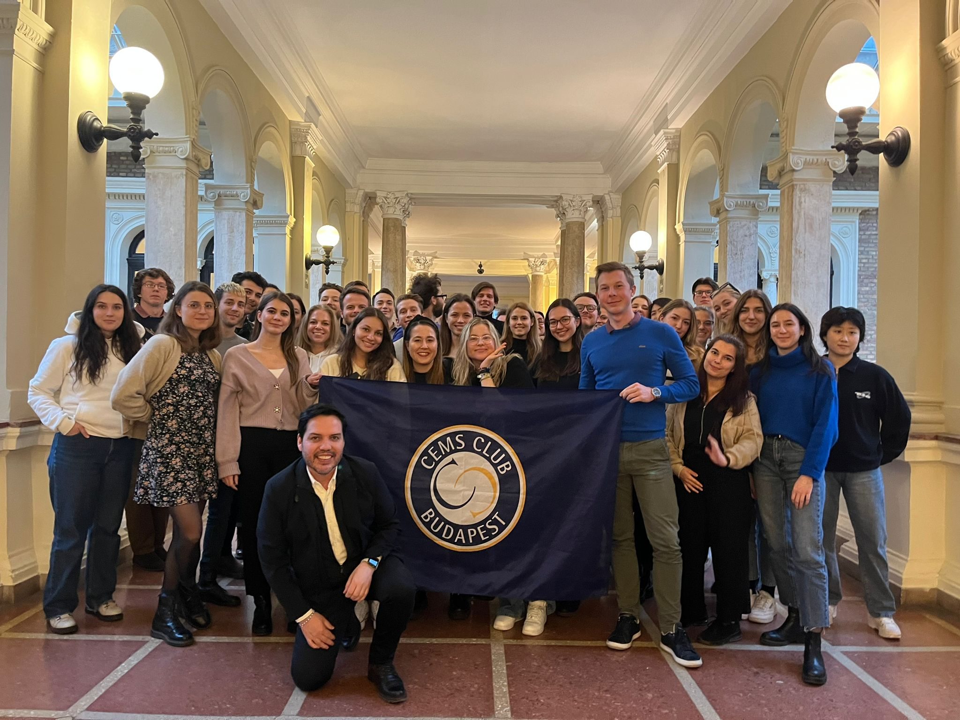


CEMS Master in International Management

Slide 25


CEMS Master in International Management
What is the CEMS Alliance?
A global community of
33 leading business schools,
70 multinational companies and
7 non-profit organisations,
who together offer the CEMS Master’s in International Management (MIM)
1300+ high-calibre, multi-lingual students of 78 nationalities
with a global mind-set
20000+ alumni of 100 nationalities working in 75 countries across the globe
– many within CEMS Corporate Partners
CEMS MIM top-ranked in the QS Masters in management rankings

Slide 26


CEMS Global Alliance
20 Member Schools
in Europe
Ivey School of Business
Cornell SC Johnson College of Business
Korea University Business School
Koç University
Tsinghua SEM
Keio University
American
University in Cairo
Universidad de los Andes
Indian Institute of Management Calcutta
HKUST Business School
Escola de Administracao Empresas de São Paulo
Universidad Adolfo Ibáñez
National University of Singapore Business School
The University of Sydney Business School
University of Cape Town Graduate School Business
26 | Introducing CEMS

Slide 27

Our European Roots – 19 member schools
Norwegian School
of Economics
Aalto University School of Business
Stockholm School of Economics
UCD Smurfit Graduate Business School
Copenhagen Business School
The London School of Economics
SGH, Warsaw School of Economics
Louvain School of Management
RSM Erasmus University
University of Cologne
University of Economics, Prague
HEC Paris
Corvinus University
University of St. Gallen
WU, Vienna University of Economics and Business
Bocconi University
ESADE Business School
Koç University
Nova School of Business & Economics
27 | Introducing CEMS

Slide 28
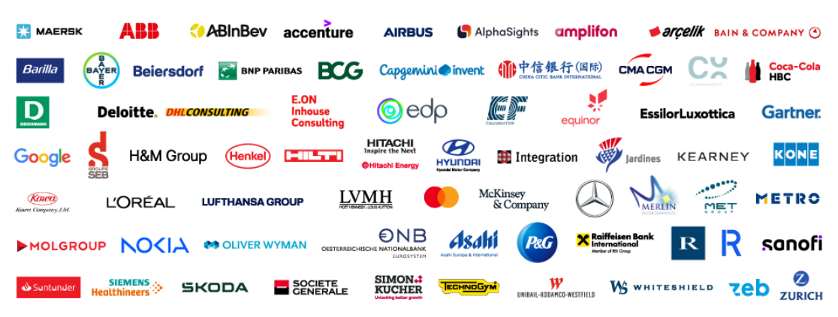

CEMS Corporate Partners
(as of March 2024)
28 | Introducing CEMS

Slide 29


MASTER PROGRAMMES THAT CAN BE COMBINED WITH CEMS
MASTER PROGRAMMES IN HUNGARIAN
MASTER PROGRAMMES IN ENGLISH
Gazdaságinformatikus MSc
Vállalkozásfejlesztés MSc
Vezetés és szervezés MSc
MSc in Marketing
MSc in Finance
MSc in Business Information Systems
MSc in International Economy and Business
MSc in Public Policy and Management
MSc in Economic Behavior Analysis
MSc in Economic Analysis
MSc in Political Economy
MSc in Management and Leadership (CEMS MIM integrated)

Slide 30
Why is it something you should consider?
Globally renowned programme
Best students
from all around the world
Unforgettable term abroad
QS ranking 2025: 10th best Master in Management in the world
78 nationalities
33 member schools
An unforgetable time and friendships that will last forever
High academic standards
Great CV
Best professors and industry experts
2 diplomas & internship abroad
Notes:
1) Globally renowned programme, as schools in CEMS Alliance are the best in the world. CEMS has also nearly 70 corporate partners. CEMS MIM is known all around the globe – it has been named one of the top Master’s in Management programmes in the world in various global rankings.
2 & 3) Meet the brightest students from all around the world – especially thanks to your term abroad and international internship. So far students from 78 different nationalities have been enrolled to CEMS MIM programme and that’s still counting. Both your semester at home school and your term abroad will make the best year of your studies as CEMS Club Budapest is taking care of all the extra activities for CEMS MIM students, always according to CEMS motto: study hard, play hard.
4) CEMS MIM at Corvinus offers not only courses led by the best Corvinus professors but also courses that are designed and co-delivered by industry experts representing such corporations as McKinsey & Company, Procter & Gamble, L’Oreal, or Mastercard.
5) Even though in many schools CEMS MIM programme is paid, it’s absolutely free for Corvinus students. You can go to the top private business schools and not pay a single cent for your education there.
6) Thanks to the global recognition your CV will stand out wherever you will want to work in the future. 82% of CEMS MIM students have worked outside of their home country, in 2-3 different countries.

Slide 31

Student experiences

Slide 32

Student experiences

