Slide 1
Territoriality in climate adaptation? Space interpretations of different disciplines and fields and their potential utilization in the examination of climate adaptation’s territorial aspects
Hungarian Science Festival
International Scientific Conference – 2023
SUSTAINABILITY TRANSITIONS: CHALLENGES AND INNOVATIVE SOLUTIONS
Thursday, 23 November 2023, Sopron
Sütő Attila
PhD student, Corvinus University Budapest International Relations and GeoEconomics Doctoral Programme, Economic Geography, GeoEconomics And Sustainable Development Institute
CHIEF PLANNER, DEP. HEAD OF DIVISION, ENERGY STRATEGY INSTITUTE

Slide 2
Initial thoughts, actuality & justification of the topic I.
Changes in climatic factors (temperature, precipitation) are perceived, growing intensity and frequency of weather extremities → serious environmental, social and economic risks
CC, Adaptation and the geographical space
Vulnerability of sectors → spatial impacts: further deepening of regional and settlement network-related differences and inequalities
originally negative social and economic processes are strengthened further
National strategic and geopolitical positions → issue of climate change must be managed in strategic planning and development policy consciously
Weight of adaptation has been improving since the Paris Agreement (2015)
Adaptation emerges as equal field besides mitigation
EU Adapt. Strategies (2013, 2021)
EU: world leader in fighting against CC (Schmidt-Thomé, 2014)
Development policy environment
CC is among the development policy priorities of the EU’s 2014-20 and 2021-27 programming periods
Medium-term objectives of the Hungarian economic development
Great emphasis is laid on Hungarian and Carpathian basin-related mitigation and adaptation interventions

Slide 3
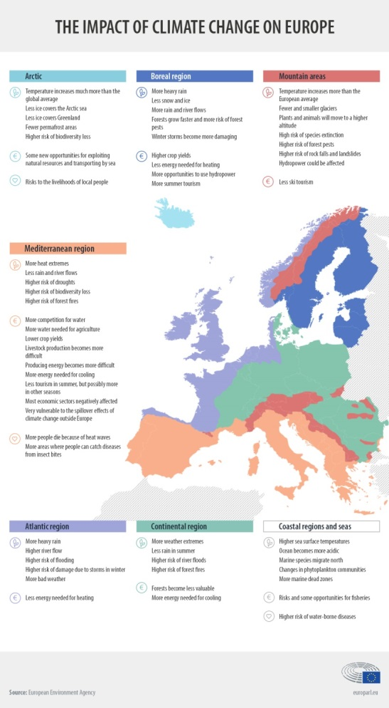
Initial thoughts, actuality & justification of the topic III.
CC’s most characteristic impacts emerge in special geographic areas
big cities, coastal zones; big river valleys, hilly territories; mountainous areas or landlocked continental plains
In these specific geographical areas special territorial answers have to be found for challenges
several national strategies and cities or regions have taken actions on their own to deal with CC impacts (Schmidt-Thomé, 2014)
Climate change, climate adaptation: serious territorial differences
between continents / macro regions / countries
…and even within countries!
Hungary: relatively small, nevertheless territorial differences are clear
Territorial characteristics matter at every level!
The question is: Are these territorial differences, territorial dimensions, aspects and spatial characteristics taken into consideration properly in adaptation policy?

Slide 4
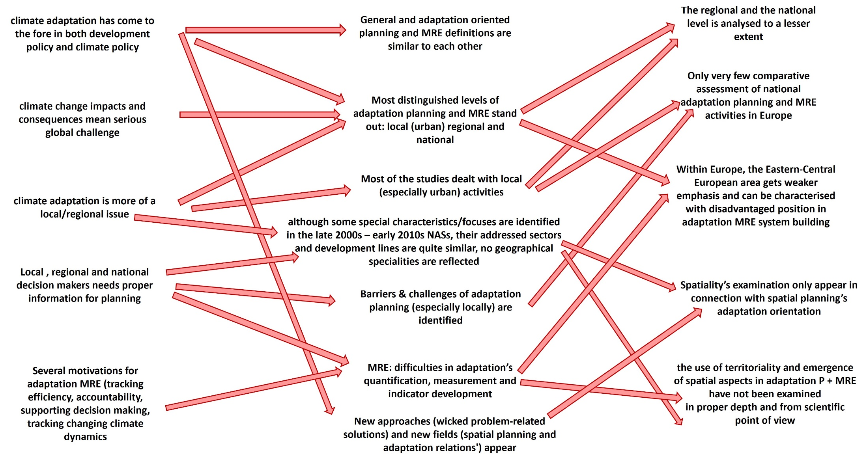
First conclusions of the literature review
situation activities’ features, methodological challenges research gaps

Slide 5
Results of the literature review – so far…
5 main phases of literature review, preliminary examinations
These will
compose the content of Chapter 1 and
Serve as basis for Chapter 3’s analyses
LITERATURE REVIEW
Planning and MRE definitions, and evolution of activities in general and in climate policy
Climate policy and sustainability aspects in EU spatial planning
Space interpretations in different disciplines
Climate adaptation, sustainability and strategic planning
Spatial aspects, territorial approaches in climate adaptation planning related literature

Slide 6
The disciplinary context
Regional Studies
Economic and Social Geography
Spatial planning, territorial monitoring
Analysis of the social and economic space, spatial perspectives
Social, environmental and economic differences of the analysed countries, regions
Territorial environmental evaluation methods
Macro regional decision
support
System theory, systemic approach
Governance, regime and public administration issues
Territorial differences of climate impacts, adaptive capacities and results
Climate adaptation MRE and planning
System of
territorial evaluations
Planning methodology
Geo-strategic role
of the Carpathian basin and the EU
Environmental evaluation methods, sustainability theories
Economic strategic and national strategic importance of climate adaptation
Global demographic and political processes, geo-political relations
Geopolitics, International relations, political and administrative studies
Environmental economy, Geo-Economy
Notes:
My exact topic idea is climate adaptation related planning, monitoring, reporting and evaluation (MRE) system development practices in Europe and their practical applicability in Central-Eastern Europe
literature review will focus on definitions of monitoring and evaluation and planning in general and especially in climate policy
the related system building practices in Western and Northern Europe as pioneering countries in MRE activities
I will concentrate on more than one disciplines, and some of them are intersecting.
One part of my 1st round literature enlisted in the attached Excel are practice oriented and from the field of climate policy MRE
the wider scope of my thesis will touch several fields.
climate policy related monitoring, evaluation and reporting are in the centre of my research interest
and in the intersection of my potential fields of research
there are of course many topics, theories, schools that are related to my topic
quantitative environmental evaluation methods of Geo-economy
spatial oriented regional studies and economic and social geography (both of them dealing with territorial differences
international relations and geopolitics also cannot be bypassed, for these fields concentrates on issues like global demographic and political processes and their consequences
different type of governances and regimes
to what extent are differences in MRE system-building practices in different countries rooted back in the differences in national administrational and governance features
Geo-economy and environmental economies
quantitative environmental evaluation methods; sustainability theories; effective policy decisions require exact information about relevant fields; preliminary assessment of expected impacts; following up measures’ achievements;
Sustainability aspects’ importance is growing in these decisions
Climate policy is strongly environment dependent
making the environmental and economic impacts, costs and benefits of measures comparable
applicable discount rate allows the effects at different times to be compared, discounting future effects to present values
M. Csutora, G. Harangozó and A. Széchy reviewed the practical application of this in the field of climate policy, although focusing on mitigation
the economic and social space oriented regional studies
problem of functional territories vs. administrational units: different sectors, thematics are operating in special territorial frameworks
similar dichotomy can be observed in the relationship between administrational units and natural geographical areas
ecological, natural processes are not organized on the basis of territorial statistical units
Economic, social, cultural and geographical spaces often can be considered as different layers upon each other
Differences within a given thematic space can be transformed into territorial inequalities
the geographical space oriented economic and social geography
both of them dealing with territorial differences
the research plans to deal with different territorial impacts and different adaptive capacities / vulnerabilities of given regions, countries, micro or macro regions)
International relations and geopolitics
concentrates on issues like global demographic and political processes and their consequences, different types of governance and regimes
the research is interested in what extent are differences in planning and MRE system-building practices in different countries rooted back to different national administrational and governance features
international comparisons should be conducted in a critical view rather than giving simple narrative description of given national examples

Slide 7
First results of literature review II. - Main interpreations of territory, space and territoriality, spatial thinking 1.
(Natural) Geography
Interprets space with empirical tools
Based on positivism/realism
Space: external endowment
Roots: natural sciences
Still the strongest impact on human space interpretations
HAGGET: space is a large area with borders; territory is a terrestrial space with borders.
Place, regions: lower levels
CRESSWELL: space is location/point with exact identities (longit., latit.)
MASSEY: place and space is „inextricably y intertwined”
FARAGÓ: postmodern interpretation separates space (general, abstract, more conceptual) and place
Territoriality: delimited/limitless geographical areas, 3 dimensions, no preferred points; „empty form to be filled in”; Substance: an ordering force

Slide 8
First results of literature review II. - Main interpreations of territory, space and territoriality, spatial thinking 2.
the geographical space oriented economic and social geography
Basically terr.differences of soc/econ characteristics
Geographic space -oriented
Different disciplines use different concepts
Relativism: humans conceptualize space even in the everyday life
Space does not derive from nature but from society
Focus on systems, networks, structures, flows
Territoriality: localized outer space of soc/econ

Slide 9
First results of literature review II. - Main interpreations of territory, space and territoriality, spatial thinking 3.
The economic and social space oriented regional studies
Developed further the earlier interpretations
Interpretative approach: different manifestations of space require different interpretations; substance of space manifests itself in variety of appearances
NNJ: difficult to discover the combined impact mechanisms of spatial (geographic) and non-spatial (social) factors
Main components of terr.dimensions: territorial inequalities and territorial order (configuration)
Spatial research prefers quantitative analysis of reg differences of lower terr. units, while thematic maps display configurations
Dualisms: objective vs subjective (perceived) space; material vs non-material space; functional vs. Administrative spaces; functional vs. Ecological spaces etc.
Lengyel I: regional study is the amalgamation of physical (geographic) space and social space interpretations
Faragó: Marxism, New regionalism acknowledge both objective space and soc/econ structures
Territoriality: distinction btw localised outer space of disciplines and inner space of social spheres.; different layers are upon each other (econ, soc, cult, geogr)

Slide 10
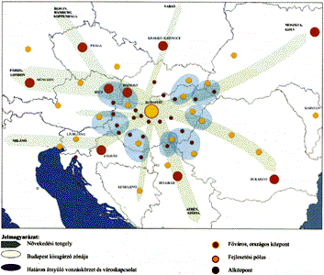
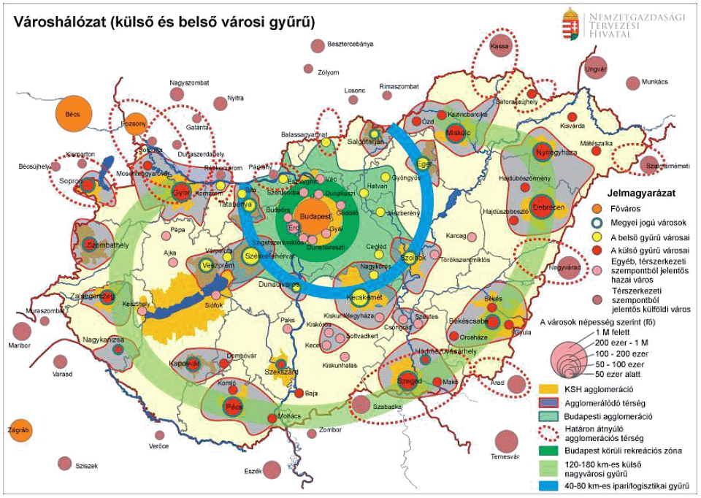
First results of literature review II. - Main disciplinary fields of the planned research 4.
Political studies, Administr. sciences, International relations
Global processes and their consequences
Geopolitical challenges
Different governance and regime types
Differences in planning and MRE system building activities
Political science and IR: social theory- based schools (constructivism, post-structuralism)
→ how historical, cultural, social characteristics influences different nations’ different PMRE activities and socially constructed internal space interpretations
Territoriality : space interpretation even effect a society’s space structure; a given government operationalizes its internal space interpretations (FARAGÓ): regionalism, centralism, polycentric or decentralised development, etc.

Slide 11
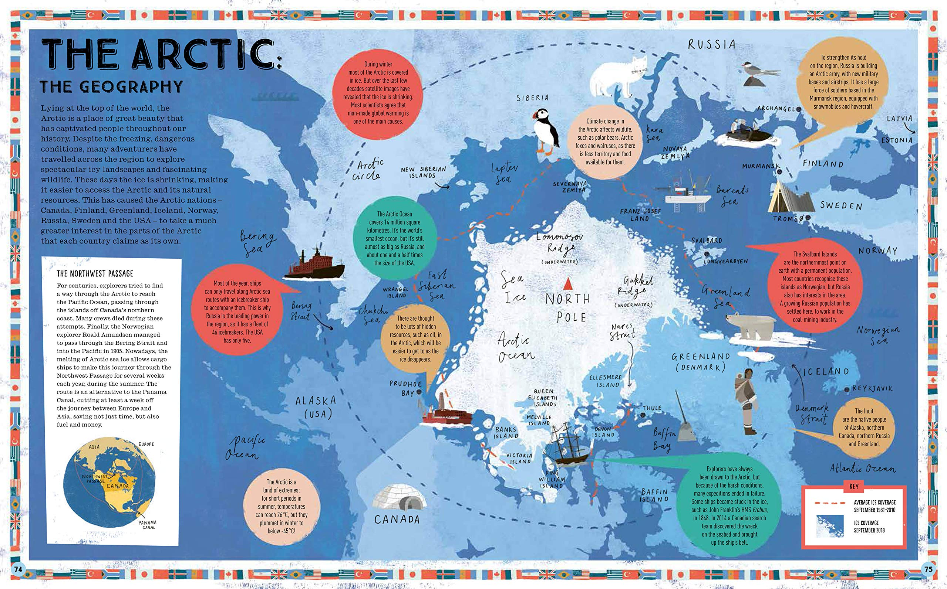
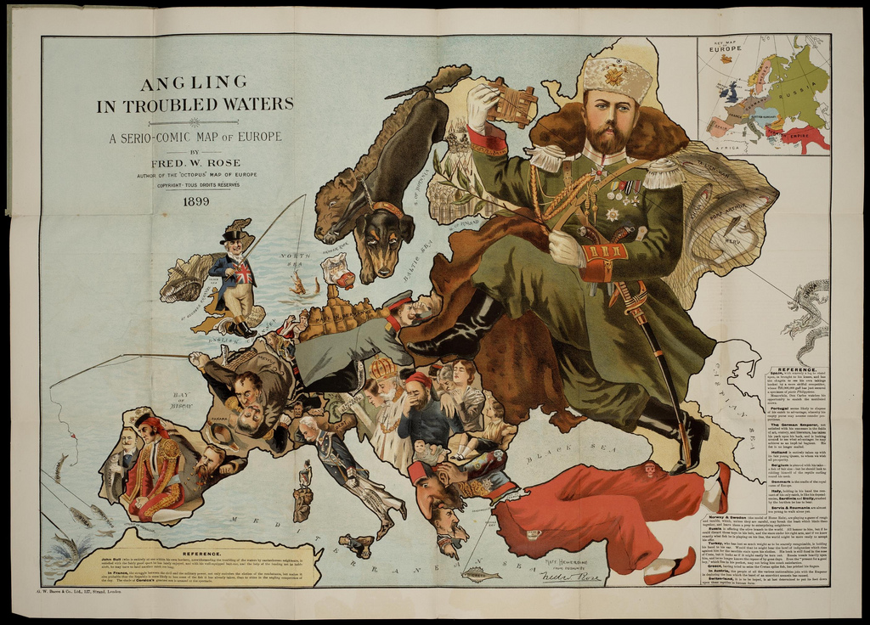
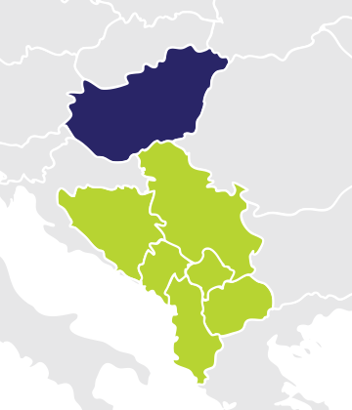
First results of literature review II. - Main disciplinary fields of the planned research 5.
geopolitics
Geography is the essence of geopolitics
It focuses on impacts of geography on politics
Localized outer spaces of politics
Given nations can use their climate (adaptation) policy to cooperate with / have influence above pother countries
Territoriality : natural geography”s primary role is emphasised; geographical factors (discovery/depletion of natural resources; movement of people, proximity, location, chaning climatic endowments) of geopolitics can be used as analytical aspects.

Slide 12
First results of literature review II. - Main disciplinary fields of the planned research 6.
Geo-economy and environmental economies
High-quality, quantified information base is a prerequisite for successful policy decisions
Growing importance of environmentally sustainable considerations
Climate policy: inseparable form geographical space & natural environment
Environmental and climate adaptation processes: impacts are distant form decisions both in space and time
Monetary evaluation of environmental goods makes economic impacts, benefits, measures comparable
My research is mainly qualitative but monitoring activities also require quantitative aspects
Territorriality: rather the internal space; economics focusing on analysis of the economic space, while regional sciences on the spatal analysis of the economy. Main focus of regional economics: position, distance, perception. Territorial indicators.

Slide 13
First results of literature review II. - Main disciplinary fields of the planned research 7.
Development policy
Regional economics’ and regional geography’s practical policy-oriented manifestation
Territorial Cohesion: among main pillars of EU development policy
Has developed from pure regional differences-balancing policy to complex policy oriented space interpretation
Peak season: TA2007-TA2020
As space interpretations, roots back to geography and regional studies
Territoriality:
mainstreaming of territorial aspects into sect policies;
comprehensive, integrated spatial planning;
place-based and indigenous development;
exploitation of territorial potential and capital;
territorial harmony;
acknowledged territorial differences of regions,
territorial optimum;
territorial governance at multiple levels
Territorial mainstreaming
Territorial optimum
Integrated spatial development
Territorial Cohesion
Territorial harmony
Territorial capital & potential
Place-based development
Territorial governance
Endogeneous territorial development

Slide 14
Use of different space interpretations in the research

Slide 15
…an indicative definition for territoriality and territorial thinking
In general, territoriality/spatiality can mean the prevalence of the above introduced territorial aspects in thinking and activities, if approaches, decisions, and actions are significantly influenced by the geographic characteristics and territorial social/economic endowments and spatial structures.
territoriality and spatiality in development policy and climate policy is the conscious and consequent taking of external and internal spatial elements and characteristics, and their territorial differences and spatial order within the absolute or relative space into consideration during the examined activities: in our case in planning and MRE, particularly in climate adaptation
We consider a policy activity territorially conscious if it put significant weight on these spatial dimensions (characteristics, differences, and configurations) both in its evidence seeking phases, reasoning and decisions (vision- and objective design and elaboration of measures), during setting up indicator sets, and when conducting evaluations or establishing decision supporting systems.
If these aspects are at least equal with the weight of the sectoral approach (separated handling of different thematic fields) or even dominate it, then we can talk about a spatially oriented approach

Slide 16
Qualitative methods’ weight is significant
main analytical focus
on existing national planning documents, MRE reports and systems;
comparison of these documents and systems
according to a predefined analytical aspect system
5-10 main factors;
and for each factor 2-4 subfactors.
Attributed to each subfactor proper principles/rules of classification will also be defined → subjectivity can be avoided

Slide 17
Conclusions I.
A wide variety of space interpretations of relevant disciplines and policy domains emerge before us.
empirical analysis will be basically space-oriented
As such, it concentrates mostly on absolute and objective space interpretations of natural geography; on the relative approach of social and economic geography, regional geography, geopolitics, and regional studies; and on those disciplines that focus on (mostly internal) space concepts implicitly (political and administrative studies, international relations, and partly even the regional studies).
On top of these even some practical fields’ (development policy, strategic and spatial planning) spatial approaches and related concepts will also be examined
we can make use both of absolutist (the container-like, 3-dimesional space with its ordering force substance) and relative interpretations (where the relation system between spatial elements is the basic regulator). The former is utilizable in the depiction of the geographical space as the place where climate change processes occur
Natural) geography’s absolute space interpretation
preserved their significant impact on human space interpretation even today, so we cannot neglect them in an examination of territoriality
relativist approach can be used in the analysis of territorial dimensions
Social and economic geography’s space considerations as a system of relations between objects is essential
concentrate on territorial differences, different territorial
vulnerabilities to climate change in given territorial units
interpretative approach is also remarkable, because the research harmonizes different manifestations of space that requires different interpretation

Slide 18
Conclusions II.
Objective spaces - external space - as localized outer space of given spheres.
Regional study, for example, focuses simultaneously on external, localized outer spaces of social/economic spheres with geographic space-attributions and on internal space structures and concepts of given spheres
applies regional analysis instead of the sector-oriented one; concentrates on different space categories parallel with each other
considers different (geographical, social, economic) spaces as different layers upon each other
Similarly to spatial planning it synthetizes different sectoral development directions onto a territorial unit
Relativist, constructivist spatial approaches also emphasise the relational dimension, regarding space as a direct product of society made up from societal relations - socially constructed internal and social space interpretations can influence society’s practical administrational spatial structure, too.
internal spaces of the given social/economic spheres might have special connection to real space organisations influencing adaptation planning and MRE system building initiatives, too
main geopolitical or geo-economic approaches - through the geographical re-orientation of their mother disciplines
interpretations in geopolitics are basically identical with the already introduced external spaces (geographical space with physical environmental elements) as localized outer perspectives
how given states can use their climate adaptation policies in strengthening cooperation with or influence above other regions. The relations between spatial elements (here: countries) come to the centre of attention. Similarly, geo-economics and regional economics concentrate on their respective localized outer spaces
Geographic space-oriented climate and environmental policy issues
applied policy-oriented space interpretations - development policy’s territorial cohesion-oriented conceptual background, and the related strategic and spatial planning activities, as applied practical manifestations of regional geography and regional economics
above-mentioned territorial cohesion-related notions and concepts
problem of functional territories versus administrational units-

Slide 19
Thank you for your
kind attention!
attila.suto@uni-corvinus.hu
attila.gergely.suto@wbgc.hu

