Slide 1

BSc in Business and Management
Dr. Judit Nagy, Programme Director

Slide 2
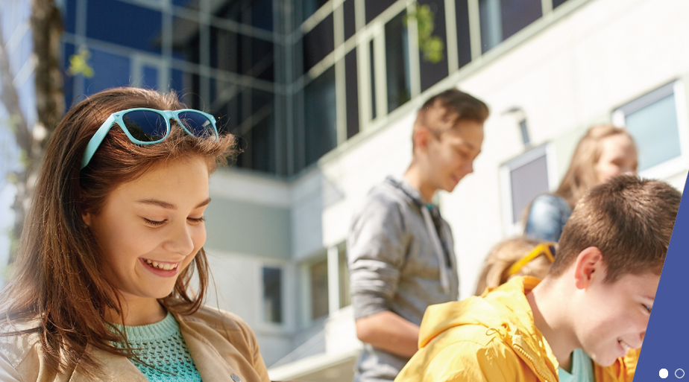
What is your goal with the university?

Slide 3
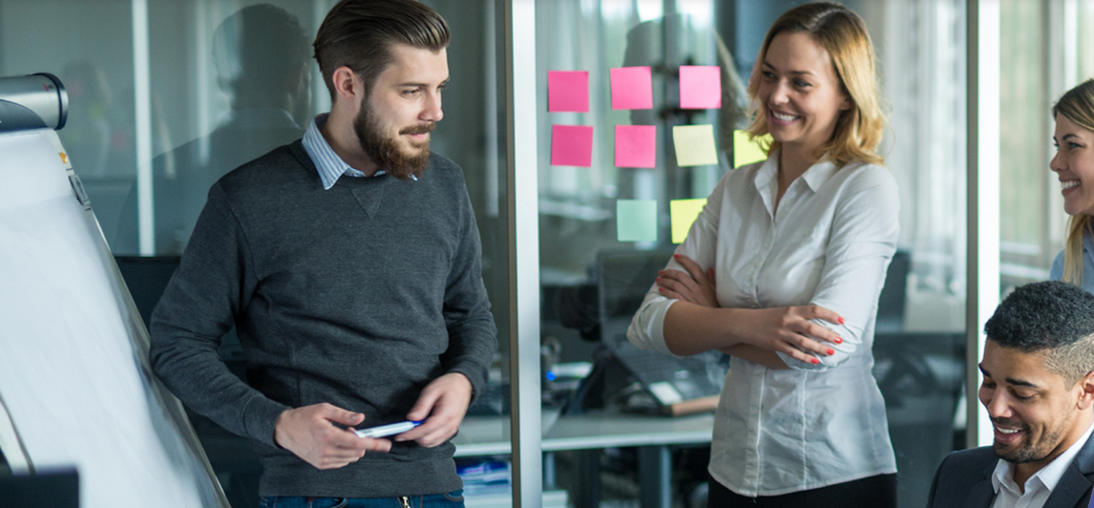
A great workplace later?

Slide 4
















A great workplace later?

Slide 5

Skill expectations
of future employers

Slide 6
Skill expectations
of future employers
Most common
Hard
Soft
language
communication
MS Office (Excel), computer skills
analytic skills
can stand on her own two feet
practical numeric skills
finance, accounting
fresh trends
team work
able to learn
able to apply her kowledge
initiative
complex / system thinking,

Slide 7
Subjects in the first semester
Most common
Hard
Soft
Mathematics I. (Calculus)
English for Specific Purposes I.
language
communication
MS Office (Excel), computer skills
analytic skills
can stand on her own two feet
practical numeric skills
finance, accounting
fresh trends
team work
able to learn
able to apply her kowledge
initiative
complex / system thinking,
Learning Methods
Business Data Analysis
Microeconomics

Slide 8
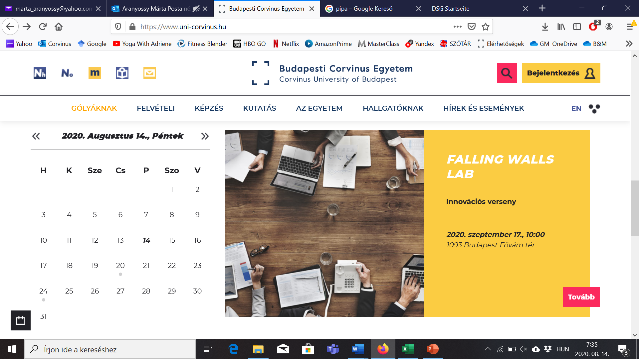
Course registration
Central process by Students Services
on 31st August evening or 1st September morning you will see your timetable in Neptun
In special cases – e.g. you are a national team athlete - if you need change, please submit a Neptun request between 01/09 10AM and 04/09 23:59 „Kérelem központilag felvett tantárgyak, kurzusok változtatására”.

Slide 9
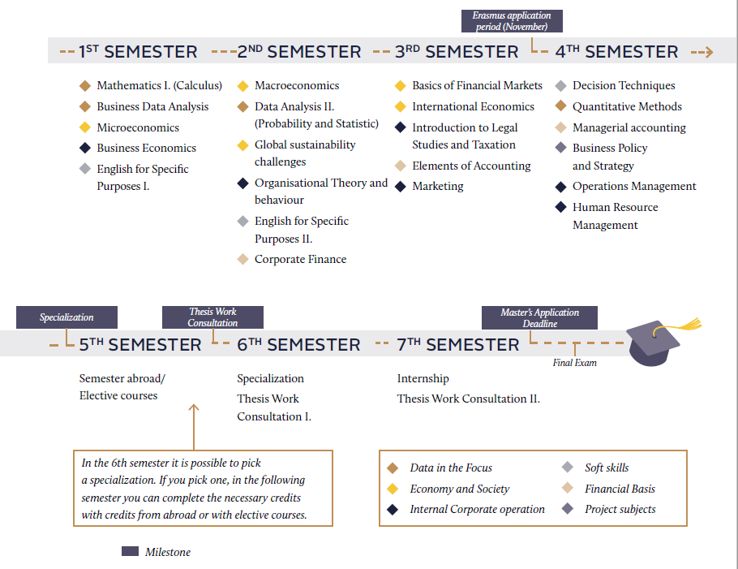

Slide 10
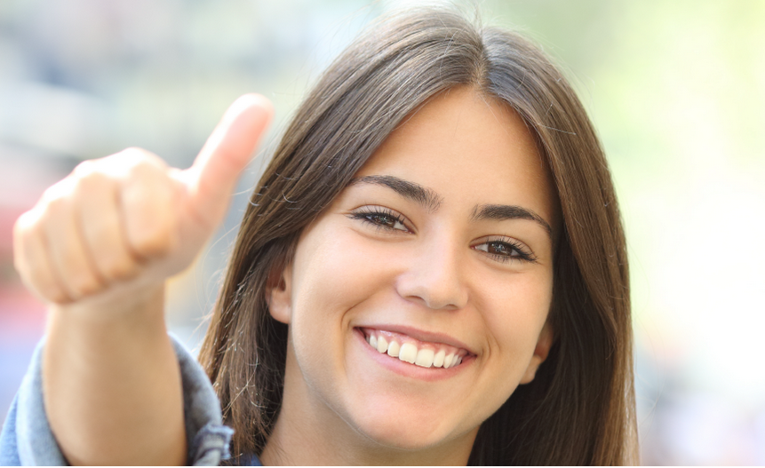
An international academic passport?

Slide 11


An international academic passport?
Program level:
University level:

Slide 12

Intellectual challenge and diversity?
Double degree programmes
Wide portfolio of electives
International case
competitions

Slide 13
Intellectual challenge and diversity?
Corvinus University of Budapest – Corvinus Business School
Bachelor of Arts in Business and Management
Double degree programmes
KEDGE Business School
(Bordeaux, France)
KEDGE bachelor degree

Slide 14
Intellectual challenge and diversity?
Business Economics seminar
Family Business
Applied International Business Methods
Üzleti gazdaságtan (for Hungarian speakers only)
Cases on Business Economics
Cases on International Business Strategy
Business Enterprise - Start-Ups
SME Marketing
Electronic Commerce
Effective e-Business Management
Economics and the European Union
The Economics and Ethics of Globalization
Essentials of Investing
Project Management
Business Protocol and Negotiating Skills
Business Ethics
Corporate Social Responsibility
International Business Case Studies
Globalization (Economic Theory)
International Business Law
International Debate
International Relations 1945 to Present
Database Management in Practice
Web Development
Managing ERP with SAP R/3
Personality Types and Team Dynamics
Global Social Change and Global Inequalities
Double degree programmes
Wide portfolio of electives

Slide 15
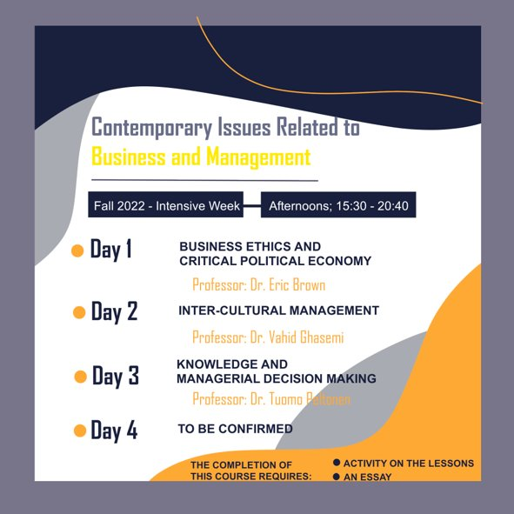
Intellectual challenge next week
Contemporary Issues Related to Business and Management
Elective course
Course code:
VF00070NABB

Slide 16

What is SPM at Corvinus?
It is a Special Finance-Mathematics supplemetary program!
It is only in Hungarian, extra course for BM students!
It is for you if you are interesten in finance and methodology or target an MSc like this.
You can choose advanced Economics program, too.
Aim: to know and practice maths, statistics and programming.
Additional info: https://www.uni-corvinus.hu/post/specialis-penzugyi-matematikai-program/
Application till 29th August 2022. midnight, by filling this form:
https://docs.google.com/forms/d/e/1FAIpQLSeyK_xd16mFYU60YGfzz-vhIt6o3DA8ctFB7rCBOTgHWUE5NQ/viewform
Admission:
  If your advanced mathematics highs school final exam is better than 85%, your application will be approved automatically
  For those, who also interested – logic test on 30th August 2022 at 5 PM in Buildinc C Big auditorium (60 min)

Slide 17
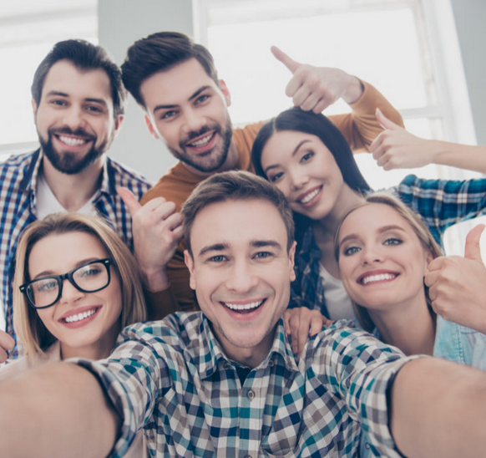
Lifelong friendships?

Slide 18
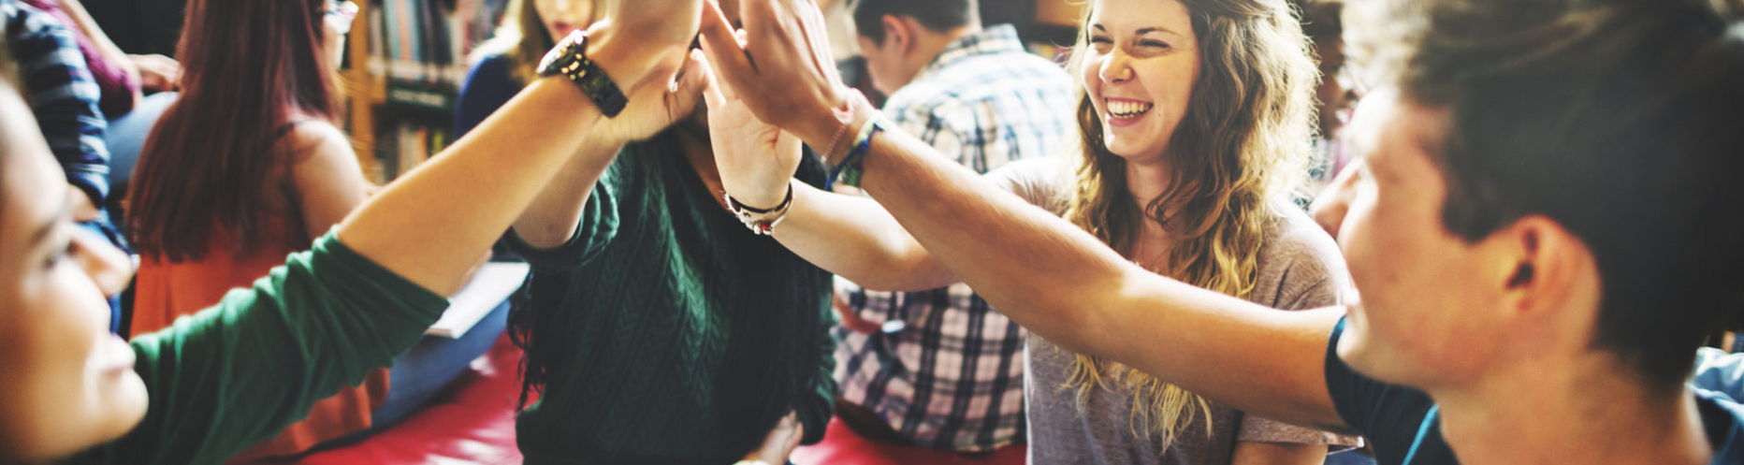
Lifelong friendships?
Student organisations

Slide 19
Lifelong friendships?
Student organisations
Internship(s)

Slide 20
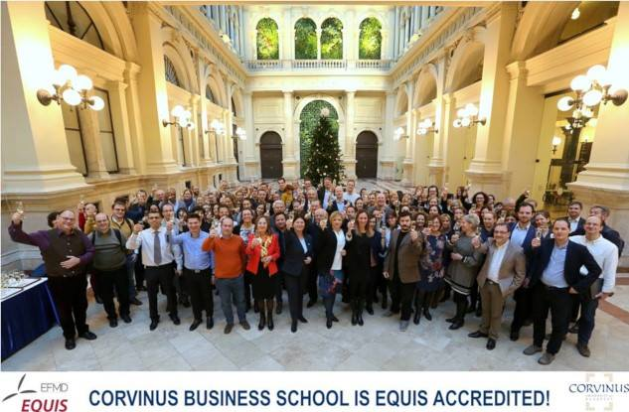
Lifelong friendships?
Student organisations
Internships
Teachers - mentors

Slide 21
Who can I turn to?
Study and Examination Regulations,
curriculum, syllabus
Help yourself!
Student Services
Course leader
They will be the solution in most cases:
Programme Coordinator
Szilvia Smith
Programme Director
Judit Nagy
Later – regarding thesis writing, intrenship, final exam:

Slide 22
Most important contacts
Student Services
Neptun
Programme Director & Programme Coordinator
Intézd online platform
Student Space: Main building, 1st floor -> take care about the office hours!
hub.uni-corvinus.hu
Access problems
Course scheduling
Course registration or dropping
Availability of Neptun requests
neptun@uni-corvinus.hu
Business and Management Center
Main building E-120 (changing!)
business.management@uni-corvinus.hu
Webpage of BSc in Business and Management: https://www.uni-corvinus.hu/main-page/about-the-university/institutes/institute-of-business-economics/for-current-students/?lang=en

Slide 23
Take control of your own university experience!
judit.nagy@uni-corvinus.hu
business.management@uni-corvinus.hu

