Slide 1

Welcome to Corvinus University
Stipendium Hungaricum Office
September 9, 2020

Slide 2


Introducing myself
Name: Doris KESZTHELYI
(feel free to simply call me Doris)
My position: Student Services – Student Mobility Office – Team Leader
My background:
20 years at Corvinus working with international students, English degree programs
8 years living abroad, i.e. experience with being in a foreign environment

Slide 3
How this session will be held – info and „rules”
Your microphones will be turned off, but you will be able to ask questions via the chat option.
All questions will be answered in writing after the session and these will be sent to all of you.
The slides of the presentation will also be sent out to you all via e-mail.
The presentation is long (sincere apologies for this), but we have tried to gather and cover all important information for the whole semester.

Slide 4
Agenda
CORVINUS
Corvinus – Budapest Campus
Stipendium Hungaricum office
Stipendium Hungaricum scholarship regulations
Academic information (very briefly)
Academic problems
Getting to Hungary
COVID-19 – Take it seriously

Slide 5
Agenda (cont.)
The Quarantine
Temporary Student ID card
Corvinus Library
Printing facilities on and around the Campus
WIFI – NEPTUN – MOODLE - EMAIL
Corvinus Support Services for students
Stipendium Hungaricum mentor program
Safety – Practical advice

Slide 6
Agenda (cont.)
Budapest - Hungary

Slide 7
CORVINUS

Slide 8
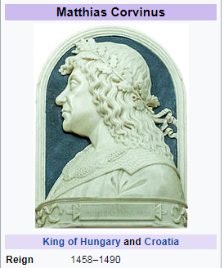


CORVINUS UNIVERSITY – A BRIEF HISTORY
1920 – the very first Faculty of Economics in Hungary is set up in the József Nádor Royal Hungarian University
1948 – the Hungarian University of Economic Sciences is established
1953 – Karl Marx University of Economic Sciences (Karl Marx’s work in economics laid the basis for much of the current understanding of labor and its relation to capital, and subsequent economic thought.)
1991-2004 – number of changes in the university’s name (structural changes)
2004 – university receives its current name: Corvinus University of Budapest
Matthias Corvinus –
the first non-Italian monarch promoting the spread of Renaissance style in his realm

Slide 9

Corvinus University
https://www.uni-corvinus.hu/main-page/about-the-university/corvinus-at-a-glance/?lang=en

Slide 10

CORVINUS -
AN INTERNATIONAL UNIVERSITY
≈ 12 000 students, ≈ 200 partner universities worldwide
Approx. 15% of the whole student body -international students from ~70 different countries each semester
A multicultural environment inside and outside of the classroom
GET IMMERSED
KEEP AN OPEN MIND
BE FLEXIBLE
LEARN FROM YOUR PEERS

Slide 11
CORVINUS – International Accreditations and Memberships
AMBA – Association of Accredited MBA-s
BSIS Label – Business School Impact System
CEMS – Global Alliance for Management Education
CFA- Chartered Financial Analyst
EAPAA – European Association for Public Administration Accreditation
EPAS - EFMD Program Assessment System
EQUIS (≈ the European AACSB)

Slide 12
Corvinus
Budapest Campus

Slide 13
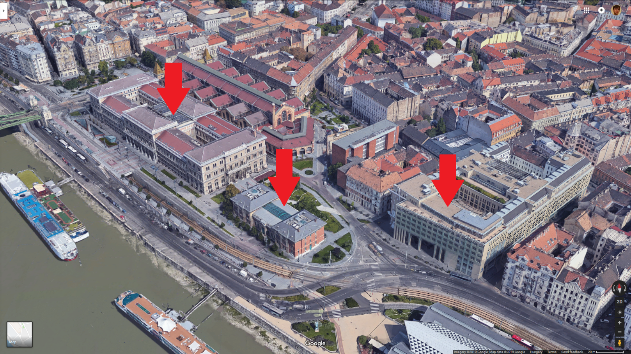
E
S
C

Slide 14

Main Building
E
Administrative offices, Student Services, lecture halls, seminar rooms

Slide 15
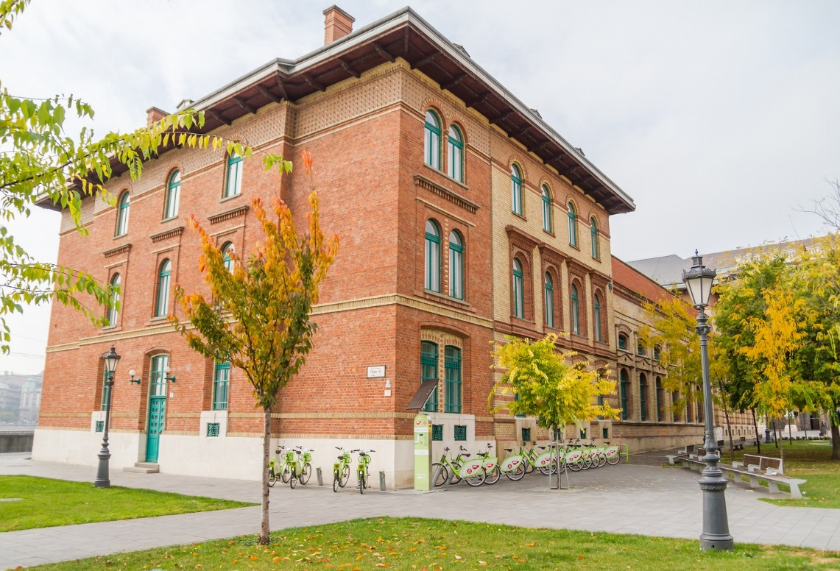
Salthouse Building
S
Institute offices, IT Helpdesk, American Corner, lecture halls, computer labs

Slide 16

New Building
C
Lecture halls, seminar rooms, Library, Financial Lab, Administrative offices, Institutes

Slide 17
Stipendium Hungaricum Office

Slide 18

Stipendium Hungaricum Office
E-mail address
corvinus.stipendium@uni-corvinus.hu
Webpage:
https://www.uni-corvinus.hu/main-page/hello-corvinus/stipendium-hungaricum/?lang=en
Office
Main Building (E)
1st floor, Room 167
Opening hours
by previous appointment only
What we are responsible for:
Stipendium Hungaricum scholarship contract
Provision of private (UNIQUA) insurance
Arranging that you be able to get your Hungarian national health insurance (TAJ) card
Arranging that you get your accommodation support and monthly stipend
What we are not responsible for:
Academic matters and problems (these must be sorted out directly with your professors, program coordinators, program directors)
18

Slide 19
Office hours
Office hours – while we work full-time from 8 a.m. to 4:30 p.m. (with a lunch hour from noon to 1 p.m.), in view of the current situation – keeping your and your coordinator’s safety in mind – you will have to schedule a meeting with your coordinator.
Information on how you can schedule an appointment will be sent out to you in due time.
Only students with officially scheduled appointments will be received.

Slide 20
General„rules”
If you have any questions or problems related to Stipendium Hungaricum scholarship administrative issues, please write to: stipendium@uni-corvinus.hu
Administrative issues = signing the Stipendium Hungaricum contract, getting the private health insurance policy, requesting the Hungarian national health insurance card (TAJ card), questions regarding SH regulations, SH accommodation and monthly stipends, extending your SH scholarship period.
IMPORTANT: We do not deal with academic matters. In matters concerning your studies, please turn to your program coordinator, program director, your professors, etc.
PLEASE BE PATIENT: all e-mails, queries will be answered as soon as is physically possible, but we, too need to eat, drink, and sleep.
ALL communication with students is in writing (e-mails and in some cases also Neptun). We do not respond to questions coming via any social media. We need to see questions in writing (not get them via phone) as we must provide the most precise information possible.

Slide 21
Stipendium Hungaricum Regulations

Slide 22
TEMPUS Public Foundation
https://stipendiumhungaricum.hu/
https://stipendiumhungaricum.hu/scholarship-holders/
Your scholarship contract!

Slide 23
About the Stipendium Hungaricum program
1. We strongly advise you to read the Operational Regulations on the Stipendium Hungaricum website to become familiar with the rules and regulations of the Programme as well as your rights and duties: https://stipendiumhungaricum.hu/apply/#rights_and_obligations .
2. As there are a lot of administrative duties at the university without which it is impossible to transfer your scholarship allowances, you can expect to receive the first transfer only around November. Therefore it is important to arrive with some financial reserve that will help you in the first two months. To have an idea of the living costs in Hungary, you can visit the cost calculator on Study in Hungary website.

Slide 24
Stipendium Hungaricum information
3. You can find almost all of the information you may need here:
  in the Stipendium Hungaricum Study Guide and Housing Guide (https://www.uni-corvinus.hu/main-page/hello-corvinus/stipendium-hungaricum/survival-guide-and-housing-guide/?lang=en). These were prepared based on questions received in previous years. PLEASE CHECK THESE before writing to ask something.
  if you read the Frequently Asked Questions section the Stipendium Hungaricum website
  If you join the Facebook community for the latest SH news, information about Hungarian culture, useful tips, cultural activities and event recommendations in Budapest and other parts of Hungary as well.
4. The scholarship allowance contributes to one person’s costs of living and it does not provide either visa or additional benefits or administration services for the person’s family members.

Slide 25
Important
The Stipendium Hungaricum scholarship is valid only for studies in Hungary. You CANNOT apply for study abroad programs such as Erasmus+.
You must stay in Hungary during the study period (from the beginning of the Orientation Week of the given semester till the end of the exam period)
  Fall: usually, the last week of August to the end of January
  Spring: late January/beginning of February till the middle or end of June.
During the study period you can leave Hungary once for max. 10 consecutive days.
In case of a longer absence, you may lose your scholarship status.

Slide 26
About the scholarship I.
The scholarship program covers your full tuition fee (but not the administrative fees) for the duration of your scholarship status
Monthly allowance for 12 months/year, except for the last year of your studies (only up to and including the month in which you obtain the final pre-degree certificate).
  The amount of the scholarship
    BA / MA students – 43.700,-HUF/month
    PhD students – 140.000,-HUF/month (1st and 2nd year)
  180.000,- HUF/month (3rd and 4th year – training research period – special application required!)
  Students must register at the SH office every September and January in order to get the scholarship.

Slide 27
About the scholarship II.
Accommodation
    dormitory (not available this semester) or
    accommodation contribution - 40. 000,-HUF/month
    you can not change the form of acc. during the semester
Medical insurance
    TAJ-card – Hungarian state insurance – blue card
    Private insurance (UNIQA) - for 5 + 7 months
No other costs are covered by the program

Slide 28
About the scholarship IV.
Mandatory participation in a „Hungarian as a foreign language and culture” course –
2 semesters in the first year of studies.
Not passing the exam = monthly allowance will only be 30 000 HUF
The scholarship can only be extended on two occasions (request must be handed in for one extra semester each time). For those starting in 2020/2021, the tuition fee will be covered by the scholarship during the extension, HOWEVER, the student will not be receiving either the accommodation or the monthly allowance during the extended period.
Study programme, host institution and study language can be changed only once and only within the first year of the full-time study program and only for the same study level (IF you meet the entry requiremenst of the program of your choice, the institution to which you wish to transfer has free places available)

Slide 29
Termination of the scholarship I.
If the student withdraws the scholarship in writing
When a student has completed a degree on the relevant study level, on the last day of the first final exam-period following the last semester,
If the student has used up the awarded number of semesters and does not submit a claim for extension, or there is no possibility to ask for extension any more
If the scholarship holder cannot prove that he/she reside habitually in Hungary,
If the student does not enroll to the institution by the given deadline and does not declare his/her scholarship status,
If the student fails to submit any missing documents (e.g. high school degree, BA/BSc degree/ MA/MSc degree until the deadline set by the institute.

Slide 30
Termination of the scholarship II.
If the student does not meet the requirement of academic progress declared in the Academic and Examinations Regulation or in the curriculum;
If the student does not obtain at least 18 credits on the average of the last two semesters where the student status was not interrupted. Each semester, this is checked for the last two active semesters. This requirement of minimum credit does not apply for the students of doctoral schools.
If the scholarship holder does not meet his/her obligations to report and supply data within the deadline.
If there is reliable evidence that the scholarship holder supplied false and untrue data effectively influencing the decision on the scholarship or s/he made such a declaration in his/her application.
If the scholarship holder does not meet his/her obligations to study or the regulations of this agreement and the laws.

Slide 31
Termination of the scholarship III.
If the scholarship holder receives scholarship from any other Hungarian governmental source parallel with Stipendium Hungaricum Scholarship, his/her scholarship will be terminated.
The host institution and Tempus Public Foundation are obliged to report the scholarship holder’s status to the National Directorate- General for Aliens Policing. The scholarship holder takes notice of the fact that the termination of the Scholarship agreement and his/her student status may result in the withdrawal of his/her residence permit.

Slide 32
What should you do now?
Apply for your residence permit – free of charge
  with D type (student) visa → Corvinus
Renewal of residence permit → Immigration Office
Getting a tax number → Tax Office
Opening a bank accout
  Send your tax number and bank account number to your study coordinator. No transfer can be done without them.
Student ID – free –your program coordinator can help
  Application in the Central Document Registering Office
  NEK-code – Neptun system
  Temporary student ID

Slide 33
Other issues
Scholarship via Neptun
  First payment: October/November (for September and October)
  Only if your bank account number and tax ID are registered in Neptun and you registered in person in the SH Office in September
Renting a flat – the accommodation contribution will be transferred to your account together with the monthly stipend.

Slide 34
Academic information
(very briefly and only very generally)

Slide 35
Fall semester – English degree programs and courses
All courses in all English degree programs will be offered in online distance learning format throughout the whole semester.
You do not have to be here to start your studies!

Slide 36
Study and Exam Regulations - excerpts
Class attendance in seminars – mandatory, max. 3 absences possible (even online!)
Registration for exams – mandatory for all students
Possible only if the student does not have any active financial obligations to Corvinus
Possible up to max. 24 hours before the date and time of the exam
(if the exam is on a Tuesday, Wednesday, Thursday, or Friday)
Possible up to max. 72 hours before the date and time of the exam (if the exam is on a Monday).
Tuesday exam at 10.00 a.m. – possible till Monday 09:59 a.m.
Monday exam at 14.00 p.m. – possible till Friday 13:59 p.m.
Max. exam opportunities in any given course: 3 (exam + 2 retakes, second retake costs 2000 HUF)
Plagiarism, cheating in any form = ethical offense = disciplinary action or failing the course
Checking exam results
Offered grades – must be accepted by student before it becomes valid (Neptun – Subjects / Offered grades)
Students are responsible for double checking the grades entered
If the course grade in Neptun does not correspond to the grade you were informed about by the professor: Neptun / Administration / Requests / „Request to review grade in a subject”
Deadline: within max. 14 calendar days from the end of the official examination period
36

Slide 37
Grading
Grading scale
The weight of the various elements of the course (participation, assignment, presentation, quiz, exam) is given in the syllabus.
Overall grades at the end of the semester and their ECTS equivalent
5 = A
4 = B
3= C
2 = D/E
1 = F
Midterms and final exams - great emphasis!
Grades are non-negotiable – you get what you earned
Participation (vs Attendance)
Group work/individual assignment
Grading scale and weight of individual parts: given in the course syllabus
  Recommendation: spread work and studying evenly throughout the semester, pay attention to deadlines.

Slide 38
Home assignments, Papers, Presentations, etc.
What is plagiarism?
Avoid plagiarism - make sure to cite any and all sources used.
Plagiarism is an ethical offense leading to disciplinary action and an automatic fail for the course
Use the spell checker before handing in your paper
Moodle has a plagiarism checker you can use before submitting your assignment (Urkund)
Plagiarism is the representation of another author's language, thoughts, ideas, or expressions as one's own original work.
Plagiarism is considered academic dishonesty.
https://en.wikipedia.org/wiki/Plagiarism

Slide 39
Exam period and exams
The exam period will start on December 14th and end on January 22, 2021.
Your exams will be scheduled by the professors sometime between these two dates (the university will be closed – i.e. no exams – from December 24, 2020 to January 3, 2021).
If you are registering for your exams and see that you have two exams at the same time, you must decide which one to take then, and which one to take later.
In general, all courses offer 3 exam dates, so such clashes can be dealt with easily.
While you are not obliged to go for the very first exam date, if you register only for the very last one, you will lose the possibility to go for a retake exam (in case you should not pass the first time around).

Slide 40
Exam registration in the
NEPTUN system
All students must register for the final exams (exam registration period will be announced) – if you are not registered, you will not be able to take the exam and/or you will not receive a final course grade!
Registration for exams (or deregistration if you change your mind):
  Tuesday to Friday exams: up to max. 24 hours before the exam time
  Monday exams: up to max. 72 hours before the exam time
  Administrative staff are not able to register you for or deregister you from exams. You must take care of this yourselves. Professors cannot overwrite the requirement for exam registraion.

Slide 41
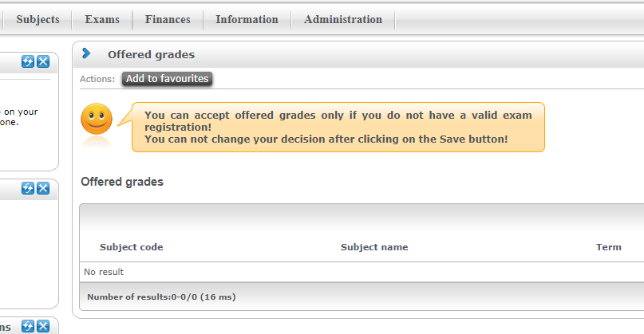
Offered grades
For „offered grades” check under „Subjects” and then „Offered grades”
In some cases, professors may decide to exempt you from having to take an exam, by giving you an „offered grade”.
You have to check on Neptun before registering for an exam to see if you have an offered grade in the given subject. If yes, you can either „Accept” or „Refuse” the grade offered by the professor. If you decide to accept it and enter this in Neptun, it becomes your official grade for the given course. If you reject the offered grade for any reason, you also have to enter this in Neptun.
Important: Once you have already registered for an exam, you will no longer be able to accept the offered grade.

Slide 42
Retake exams
If you should fail an exam or are not satisfied with the course grade, you can choose to take a retake exam.
In the case of practical grade courses, this is not an option as you will be graded based on your academic performance during the semester.
It is always the very last grade that counts, i.e. (there is a possibility, that by going for the retake exam, your final course grade may end up being worse than it originally was.
You can only retake a successful exam in a single course each semester.

Slide 43
ACADEMIC PROBLEMS
Academic problems

Slide 44
In case of academic problems
Try to sort out all problems directly with the professors – and as soon as they arise.
Professors are not ogres and will be happy to help if approached. BUT: Be honest and „diplomatic”, do not be overbearing or pushy.
If the above doesn’t help, turn to your program coordinator – provide all background info about the problem. The coordinator will do his/her best to help or will contact a person who can (Head of Department, Head of Institute).

Slide 45
Know the Study & Exam Regulations!
Read the course syllabi
Allow Neptun to forward Neptun messages to your e-mail address – the one you read.
Check your spam filter !

Slide 46
ACADEMIC PROBLEMS
Getting to Hungary

Slide 47
Entering Hungary
3rd country nationals
Visa for the purpose of studies („D” type visa)
Letter of Acceptance
Letter of Award for the Stipendium Hungaricum scholarship
Certificate from the university
Proof of accommodation (university dorms will not be open to international students in Fall 2020)
Police equity approval to enter Hungary. To submit a Police Equity Request to enter Hungary: fill in form „Equity request to enter the country (no login required) – Form ID COVID-02) - https://ugyintezes.police.hu/en/meltanyossagi-kerelem

Slide 48
Residence permit – When you have received it
  Send a scanned copy of the residence card via e-mail to your program coordinator (NOT TO THE STIPENDIUM OFFICE)
  We will enter the required details in Neptun (legal obligation for the university) and will then – in keeping with the GDPR regulations delete the file you sent.
ALWAYS have it with you if you leave Hungary and plan to return!
48

Slide 49
COVID-19
TAKE IT SERIOUSLY

Slide 50

Currently available information on quarantine and PCR tests – I.
As of September 1, 2020, international students will be able to enter Hungary only if they immediately go to their previously arranged accommodation address and stay in quarantine for the mandatory 2-week period.
Students will have to enter on the certificate provided by Corvinus the address where they will be spending the
2-week quarantine.
As already indicated, the university dormitories will not be able to host any international students.
Source: https://www.portfolio.hu/gazdasag/20200901/koronavirus
50

Slide 51

Currently available information on quarantine and PCR tests – II.
Corvinus students will be able to arrange to take the PCR test via the Semmelweis University. Information on how, when and where the PCR test can be arranged will provided later.
Important: Leaving the quarantine without permission to do so from the relevant authorities is illegal and will result in immediate dismissal from the university.
Just a sample of possible options to order groceries, food, etc.: Real Food; Tesco; Pagony Grocery Store; Netpincer, etc.
Source:
https://koronavirus.gov.hu/cikkek/ezert-fontos-hatosagi-hazi-karanten-bevezetese-es-betartasa
51

Slide 52
If you are feeling ill / worse
(shortness of breath, high fever, etc.)
You will be informed about any up-to-date information continuously
Check your e-mails (also the Spam folder), check the Corvinus website
Check the ESN social media pages (see later on)
Call 104 (+36 104) – Ambulance
Be ready to go to hospital (have your health card with you)
Inform us by e-mail (copy to coronavirusinfo@uni-corvinus.hu)

Slide 53

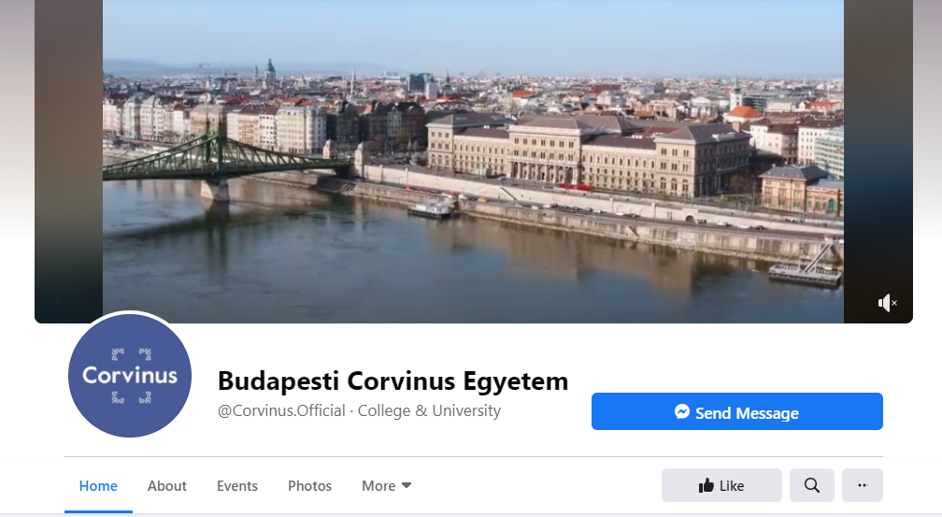
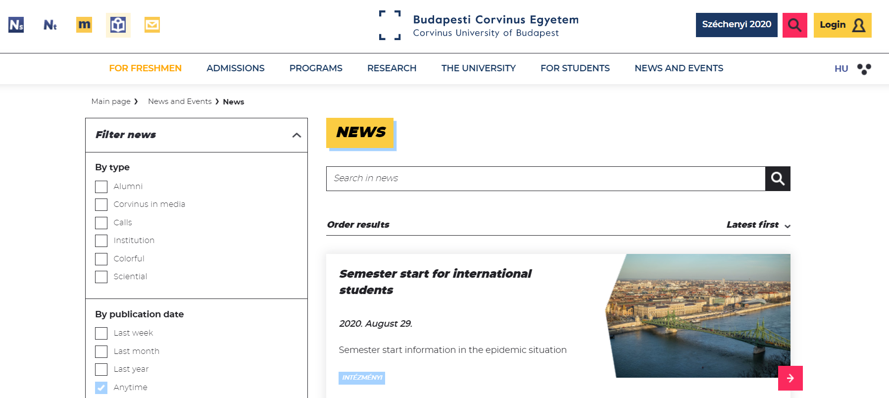
Official & Corvinus sources of information
Official sources of information
https://www.kormany.hu/en
https://koronavirus.gov.hu/
http://abouthungary.hu/
Corvinus sources of information
https://www.facebook.com/Corvinus.Official
https://www.instagram.com/uni.corvinus/
https://www.uni-corvinus.hu/main-page/news-and-events/news/?lang=en
53

Slide 54
The Quarantine

Slide 55
Can I leave my apartment / room during the quarantine period?
NO!
Important: Leaving the quarantine without permission to do so from the relevant authorities is illegal and will result in immediate dismissal from the university.
During the quarantine period, the student cannot leave his/her designated accommodation and, of course, cannot enter any of the Corvinus university grounds (including the Budapest Campus buildings and all the buildings of the university’s other sites).
55

Slide 56

How will I follow my courses?
Students will be able to follow - in an online, distance learning format throughout the whole semester – all the lectures and seminars of the courses offered in the frame of the English degree programs, as well as, courses offered to incoming international exchange students.
56

Slide 57
Temporary Student ID „card”

Slide 58
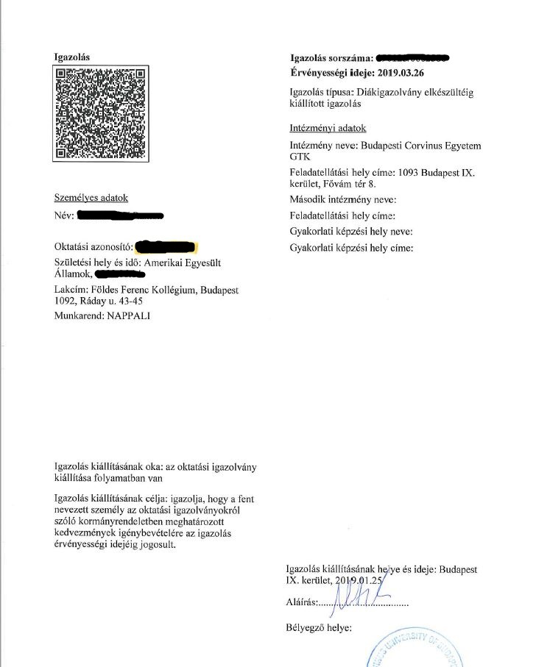
Temporary Student ID card (issued by your program coordinator!)
Only valid in Hungary!
Issued by Corvinus
You must have it with you if you use any of the benefits/discounts
Valid for 60 days from the date of issue
Request a new temporary Student ID at least 2-3 days before it expires.
Benefits/Discounts:
  Student public transportation pass (Budapest) –
  3450 HUF/month
  Train 50% - only within Hungary
  Movies, gyms, restaurants etc.
ID number to put in when buying a public transportation pass
Date of expiry
58

Slide 59

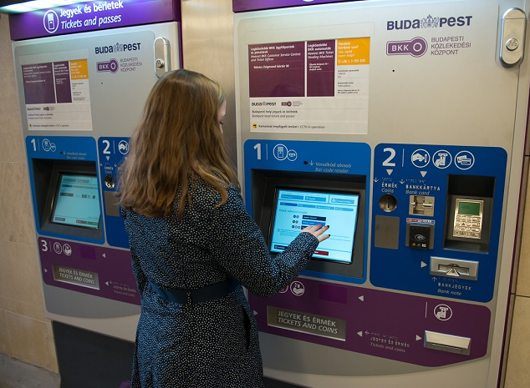
Public Transportation Pass for Budapest
Student transportation pass - 3450HUF/month
Only valid with your student ID! (Fine of 16000HUF=60USD)
What number do I have to
enter as the ID number?
„Oktatási azonosító” on your
temporary Student ID card
Where can I buy it?
OR:
https://bkk.hu/mobileticket/
More info:
https://bkk.hu/en/monthly-budapest-pass-for-students-2/
It must be:
Monthly pass for students
59

Slide 60
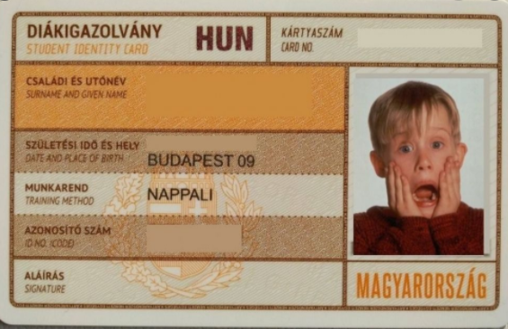

Regular student ID
You will have to apply for a regular student ID card. Information on how to do this will be provided by your program coordinator.

Slide 61
Corvinus Library

Slide 62
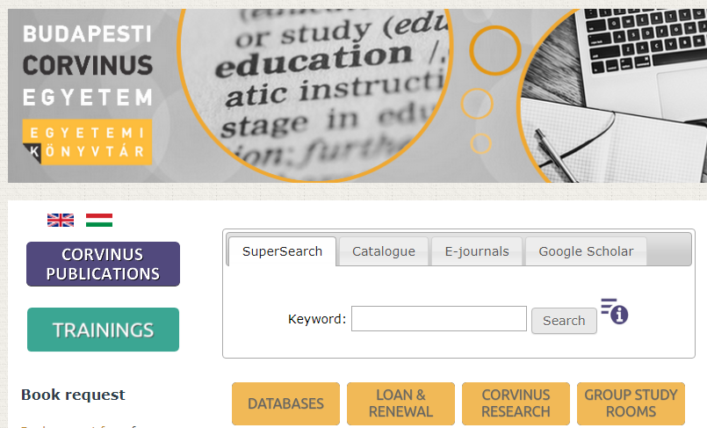
Library related information – registering, using, loaning out books, etc.
All international students have received an information letter via e-mail from the University Library.
Please take the time and effort to read the information provided carefully.
https://www.uni-corvinus.hu/main-page/research/university-library/?lang=en

Slide 63
Printing Facilities
on and around the Campus

Slide 64
PRINTING FACILITIES
New Building - Library:
    scan-print-photocopy
Main Building:
    Student Council: Room 17 (+ faxing)
Print shop
    Room 55 (next to the smaller buffet)
Copy Center
    Between Main & New Building

Slide 65
WIFI – NEPTUN - MOODLE – E-MAIL

Slide 66

Neptun – Moodle – E-mail
https://www.uni-corvinus.hu/?lang=en
Neptun for students
Moodle
Library
E-mails

Slide 67
Corvinus WIFI
Cusman user name (Neptun code – lower case) &
Cusman password
Look for - Cornet-EAP
Any problems? - wifi.uni-corvinus.hu
Wireless Technical support –
Salthouse rooms #124, 125, 126
Monday-Thursday: 9.00-12.00pm / 1.00-4.00pm
67

Slide 68
Corvinus Support Services
for Students

Slide 69


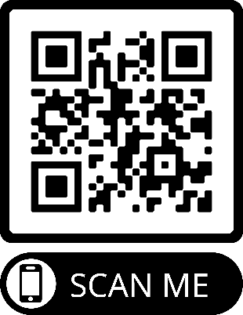
If you struggle with academic challenges
If you have doubts about your career plans and skillset
If you feel concerned about university or personal matters
If you have any special needs concerning your studies
We are with you

Slide 70






Study Management
Career Coaching
Career planning
Professional goals and self-awareness
Study-work-private life balance
Soft skills
CV and interview training
Learning strategies
Exam stress
Presentation anxiety
Thesis panic
Performance anxiety
Disability
Support for students with special needs
Mental Health
Intercultural issues
Family and relationship conflicts
Anxiety, stress
Unexpected life events
Loss, grief
Identity questions
Crisis
NapKözi
Well-being projects
Peer mentors
Chill-out zone

Slide 71



Contact the CUB
Student Support Team
studentsupport@uni-corvinus.hu
We are with you

Slide 72


Stipendium Hungaricum Mentor Network

Slide 73
What is „HÖOK” ?
National Union of Students in Hungary
Students’ representation
Brings solutions to problems that go beyond the universities’ decision-making offices
Each university and each student in Hungary is a member of HÖOK

Slide 74
What is the Stipendium Hungaricum Mentor Network?
A network to help the cultural and educational integration of students coming to Hungary with Stipendium Hungaricum scholarship
Was created thanks to the negotiations between the National Union of Students in Hungary and the Ministry of Human Capacities
Greatest project of the National Union of Students in Hungary, with the most significant priority
Supported by the Ministry of Human Capacities

Slide 75
Aims of the Stipendium Hungaricum Mentor Network
Peer assistance
Help the integration of foreign students
Show Hungary’s geographical, historical and cultural values
Promote the political and educational aims of the Ministry of Human Capacities

Slide 76
Sturcture of the Network
Management
Institutional leading mentors
Senior mentors
Mentors

Slide 77
Tasks of the Mentors
Help in administrative and official procedures
Assist the mentees to overcome their educational problems and challanges
Stay in touch
Help with public transportation
Motivate the mentees to participate in cultural programmes organised by the Network

Slide 78
shmentor.hu
www. shmentor.hu
Online surface used for:
  registering to the network
  choosing mentors
monitoring the mentors’ work
  registering to cultural programmes
  communication

Slide 79
Safety – Practical advice

Slide 80
PRACTICAL ADVICE
Health insurance
  - understand how your insurance works before there is a problem
  - Always have your card/document with you
112 – Emergency phone number
Taxis
  - always order one by phone/app (City Taxi, Főtaxi, Bolt, Taxify, etc.)
Helpful apps:
  - BKK Futár (public transportation, in English)
  - Currency exchange
  - Offline map (MapsWithMe, GoogleMaps)
  - Google Translate
Useful website: https://welovebudapest.com/en/

Slide 81

What can happen ?
Stolen mobile phones, residence cards, passports, wallets - POLICE
Police case
Caught for drug usage and possession – ZERO TOLERANCE
Student disappears – keep track of each other, let us know if you think someone is missing!
Car accident – POLICE, if needed HOSPITAL – inform us
Serious allergic reaction to food – EMERGENCY ROOM, inform us
Death in the family back home – STUDENT COUNSELING, inform us
Depression, panic attack – STUDENT COUNSELING
Boyfriend/girlfriend back home breaks up with the student – STUDENT COUNSELING
Scamming - POLICE

Slide 82

Pay attention!!!
CHECK the bill
CALL a taxi company (City, Főtaxi, etc,) at night
USE yellow taxis and always CHECK the meter
In case of a problem – WRITE down the # of the Taxi
Be aware of your surroundings!
Drink with discretion

Slide 83
Budapest and Hungary

Slide 84





HUNGARIAN CULTURE – IS IT JUST THIS?

Slide 85












NO – IT IS ALSO THIS !

Slide 86
BUDAPEST AND HUNGARY
Fills the role of a „bridge” between West and East
A business hub (international and multinational companies, regional directorates, etc.)
A cultural hub
A multicultural country with people from many countries living here and working together

Slide 87
Thank you for your attention!
On behalf of Student Services and the Stipendium Hungaricum office
I wish you successful studies at Corvinus

