Slide 1
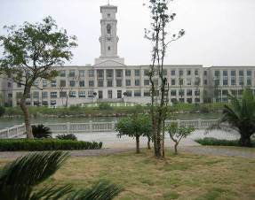
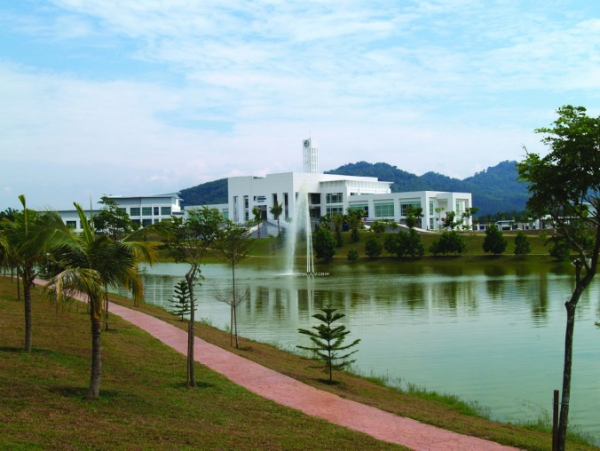
Establishing Campuses in Asia
Christine Ennew
Provost and CEO, University of Nottingham Malaysia Campus

Slide 2
Overview
The “Macro Context”
The University of Nottingham and its campus in Malaysia
Issues and Challenges

Slide 3
The Macro Context (HE is still nationally bound)

Slide 4
Campus developments are welcomed by hosts because……
Immediate instrumental needs
Campus developments can support the rapid development of a skilled domestic workforce
Campus initiatives can help to deliver student numbers supporting the vision for an International HE hub
Longer term, developmental needs
Campus developments can support the development of research capacity and capacity for innovation
Broader learning and knowledge exchange in all areas for HE

Slide 5
Campus developments are regulated by hosts because……
Need to realise the benefits that international campuses offer
Ensure quality of educational and broader student experience
Ensure appropriate levels of consistency with domestic systems, principles, values
Prevent opportunism by institutions (revenue considerations must not dominate)
Protect students given the difficulties of assessing HE opportunities

Slide 6
Campus developments attract interest from source country regulators and policy makers because……
Need to protect reputation and quality of national systems
Need accountability domestically in relation to the use of public money
TNE providers are the face of the source system
Broader impacts on international relations

Slide 7
The UNMC Case Study

Slide 8
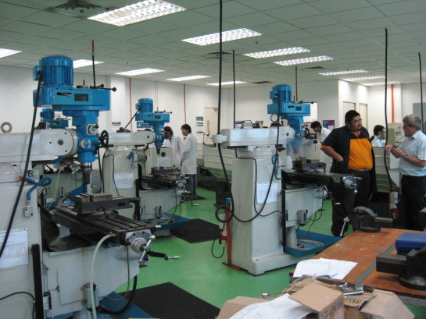
Why invest in international campuses
Pull factors
Reaching new markets and new talent - recognition of market opportunities – population growth, excess demand, significance attached to education
A UK education but not with a UK price tag (attractive cost conditions)
Providing our students with an international experience – contributing to employability
Brand – a global presence will have significant impact on reputation and research

Slide 9
Why invest in international campuses
Push factors
Changed domestic funding regime increases the importance of the international dimension
Changing patterns of demand – unfavourable demographics
Changing patterns of competition – other countries increasingly important as destinations for international students
Domestic market constraints on further growth

Slide 10
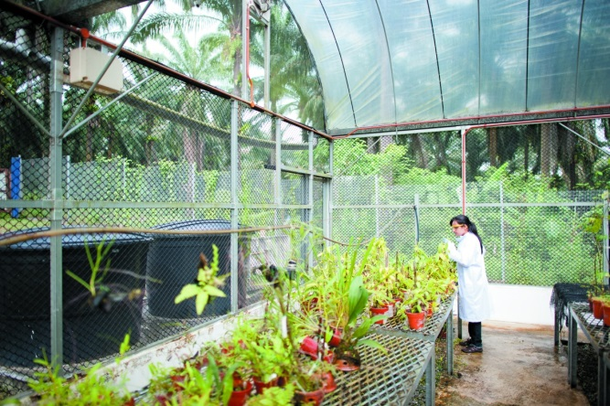
Why invest in international campuses
Enabling factors
Government regulations in host countries
Malaysia 2020 Vision, well developed private HE sector
2003 law in China, policies encouraging foreign providers
Vision and leadership from the UK
Culture – bias to action, internal locus of control, regulations support but do not constrain
Governance – robust but supportive
Financial strength

Slide 11
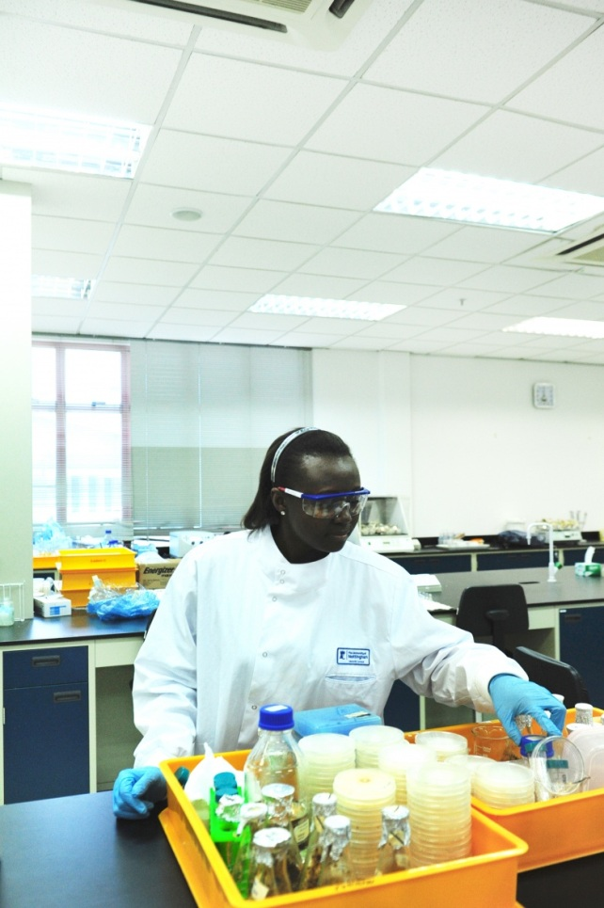
The Concept
UK degree awarding powers
A UK style education – curriculum, pedagogy, systems, language, resources
The “Nottingham” experience – leadership from seconded staff
Multi-campus schools – academic units at the campuses are part of the School at the UK campus
Student exchange and mobility
International staff and international students
Research active

Slide 12
The implementation
Legally, both campuses owned by joint venture companies
Academic CEO with representative boards
Mix of locally recruited, international and seconded staff
“Private” Universities within the local jurisdiction
Academic matters are wholly managed by the University of Nottingham
Quality assurance and standards determined by the University of Nottingham
Student experience and services – aligned to UK principles but adapted for local context

Slide 13
Operational Challenges

Slide 14
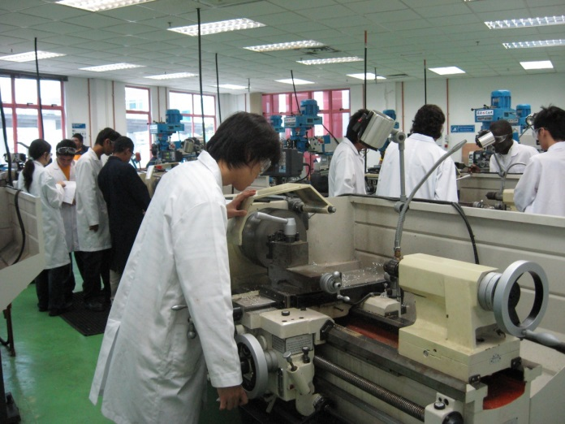
The Educational Challenge
Education aligned to domestic QA systems and processes – comparability in quality and standards
Overarching regulatory framework – autonomy v govt control
UK – QAA, qualifications framework, audit and enhancement
Malaysia – MQA, qualifications frameworks, course approval process, fee regulations
Professional Accreditation – whose professional bodies
Aligning domestic students and students returning from abroad

Slide 15
Educational Delivery
Focus on “equivalence” – consistency at the core but scope for adaptation
A British style education – curriculum, pedagogy, systems, language, resources
A “one University” concept, multi campus schools, cross campus governance
Student and staff mobility
Accept multiple regulatory regimes
British in origin and style but locally embedded

Slide 16
Student Life
University is more than just the core education
Delivering in relation to co-curricular activity
Student experience and services – aligned to British principles but adapted for local context
International campuses have greater control but also require greater investment
Working flexibly and sensitively with local norms

Slide 17
The Staff Experience
Promising the home campus experience but operating under local law and policy
Employment terms and conditions
Dealing with cultural differences (responsibilities, behaviours, policies – eg equal opportunities)
Student expectations inside and outside of the class room
Nature and scale of research opportunities

Slide 18
Partner Relationships
Educational or commercial – our partner is a commercial entity and unfamiliar with HE
Aligning interests of both partners – awareness of how we deliver value to them and how they deliver value to us
Text book example of the challenges of managing a JV
No easy solution but
Communication is key
Flexibility and adaptability
Compromise

Slide 19
Conclusions

Slide 20
Malaysia Campus - Students

Slide 21
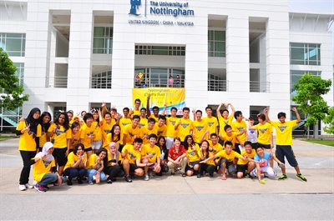
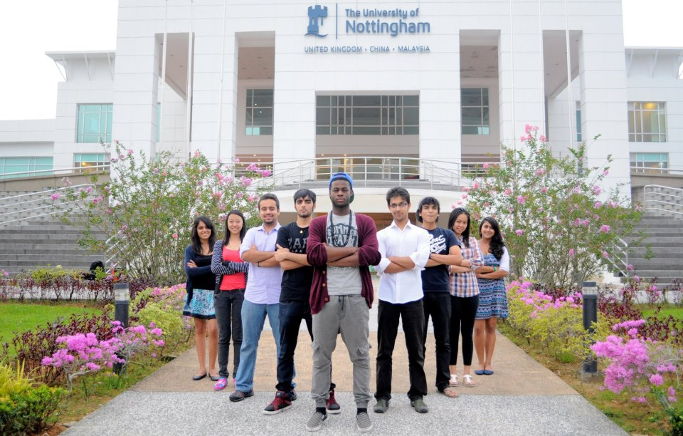
Student Achievements

Slide 22
Research Grant Income
Year | Government (‘000 RM) | Total (‘000 RM)
2005 | 15 | 15
2006 | 553 | 690
2007 | 1,492 | 2,280
2008 | 2,468 | 3,174
2009 | 1,640 | 3,873
2010 | 1,944 | 3,833
2011 | 4,598 | 8,680
2012 | 1,870 | 5,058
2013 | 5,703 | 9,882

Slide 23
Main challenges
Adapting to context – getting the balance between being fundamentally British but locally embedded
Balance may differ for students and staff
Governance – the complications of different regulatory regimes
QAA and MQA )and professional bodies)
Aligning University governance with JV requirements
Management - ensuring the necessary local autonomy alongside the need for a coherent and consistent approach to delivering against the core values and expectations of the “home” campus.

Slide 24
The Future
A growing role for private provision – bringing diversity and resilience into HE systems
The role of private HE – transitioning to greater research engagement – and the associated funding issues
International activity expanding – fuelled by the growth in demand – esp in Asia and Africa
More international campus-type activity
Challenges for institutions to implement sustainably
Challenges for governments in balancing domestic public and international private provision

Slide 25
Thank You!
Questions and Comments please

