Slide 1
Starting off at a run or stagnation in the internationalization of Hungarian universities
József Berács
Corvinus University of Budapest
Center for International Higher Education Studies (CIHES)
„Hungarian Higher Education 2013”
On the Road of Internationalization – Starting off at a run or stagnation: 2014-2020
Budapest, 19 January, 2014
Corvinus University of Budapest

Slide 2
Main topics
Why internationalization? Why international mobility?
International export market orientation in higher education
Incoming and outgoing student, professor, staff member mobility
Macro and micro, government and institutional actions are needed
Scenarios, ladders of international competitiveness of Hungarian universities, the road to 2020, 2030

Slide 3
U-MAP Model: Indicators of internationalization 2010
E/1 Proportion of foreign, fulltime incoming students in total (7,5%)
E/2 Proportion of exchange incoming students in total fulltime students (0,6%)
E/3 Proportion of exchange outgoing students in total fulltime students (1,1%)
E/4 Proportion of academic staff working abroad in total fulltime (0,4%)
E/5 Proportion of foreign citizens in academic staff (fulltime) (1,5%)
E/6 Proportion of foreign R&D revenues in total R&D revenues (2,2%)

Slide 4
International export market orientation conceptual approaches in higher education
The market orientation construct in the literature
  Customer orientation, competition orientation, inter-functional coordination
  Market intelligence generation, dissemination and responsiveness of the organization
The antecedents and the consequences of market orientation
  Top management emphasis, risk aversion, conflicts, organizations
  Commitment, business performances, positions in rankings
The market driven motivation, the reward systems in micro and macro level

Slide 5
Export and import, incoming and outgoing students in the Hungarian higher education
Categories | 1980/81 | 2005/06 | 2010/11
Fulltime students | 64 100 | 231 482 | 240 727
Foreign students | 2 700 | 10 974 | 15 889
Proportion of foreign students (%) | 4,21 | 4,74 | 6,60
Hungarian students studying abroad | 1 725 | 7 458 | 10 000 estimation
Proportion of Hungarian students studying abroad (%) | 2,69 | 3,22 | 4,15
Balance of export/import (%) | +1,52 | +1,52 | +2,45

Slide 6
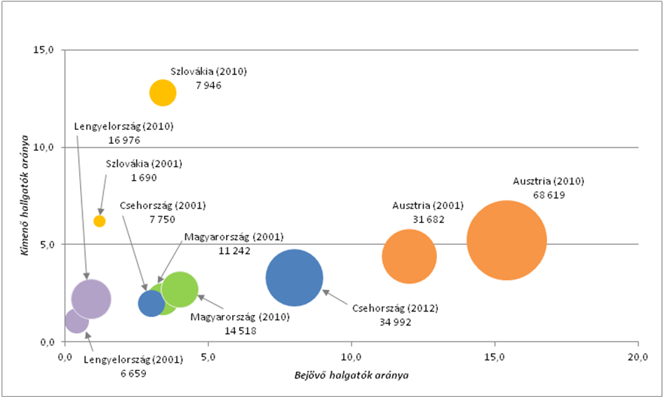
Proportion of inbound and outbound students in a few neighboring countries, 2001/2010

Slide 7
Countries sending more than 100 students (2011/2012)
Neighbouring country | Number | Europa | Number | Other Continent | Number
1. Romania | 2 736 | Germany | 2 342 | Iran | 979
2. Slovakia | 2 533 | 2. Norway | 812 | 2. Israel | 743
3. Serbia | 1 646 | 3. Sweden | 440 | 3. Turkey | 520
4. Ukraine | 1 328 | 4. Spain | 328 | 4. Nigeria | 483
5. Austria | 140 | 5. France | 302 | 5. USA | 426
6. Croatia | 135 | 6. Great-Britain | 261 | 6. China | 290
 |  | 7. Cyprus | 232 | 7. South Korea | 259
 |  | 8. Italy | 232 | 8. Vietnam | 227
 |  | 9. Ireland | 194 | 9. Saudi-Arabia | 223
 |  | 10. Greece | 185 | 10. Japan | 215
Total | 8 518 | Total | 5 709 | Total | 4 551
Country group % | 42,2% | Country group % | 28,3% | Country group % | 22,6%

Slide 8
Number of foreign students at top ten Hungarian universities (2011/2012 fulltime)

Slide 9
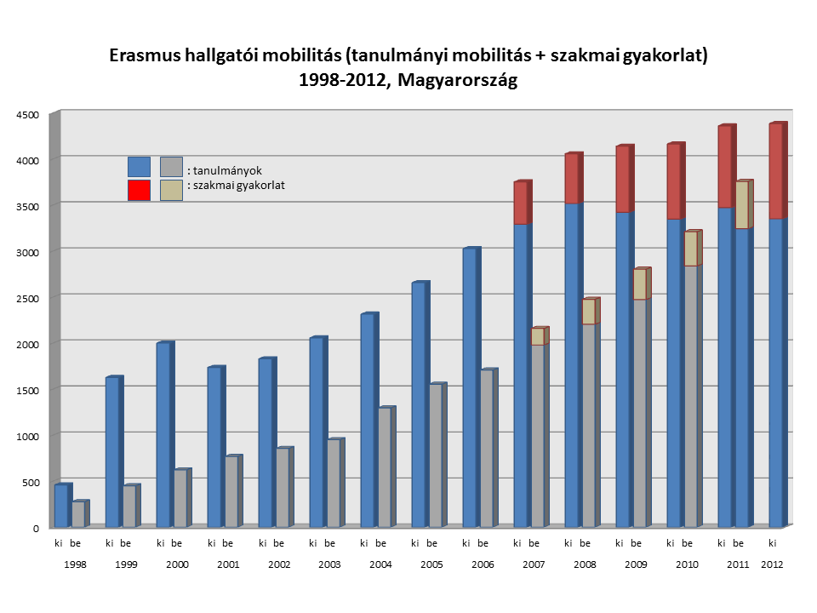

Slide 10
Seven steps of improving language capability and internationalization level of students (ladder)
First level: monitoring the language capability of enrolled students
Second level: taking courses in foreign languages with foreign students
Third level: short courses, periods, study tours abroad
Fourth level: semester (30 credits), internship abroad
Fifth level: sandwich program, certificate or degree of partners
Sixth level: joint degree, degree of international consortium
Seventh level: earning degree only in foreign university

Slide 11
Potential Government Targets (1)
Hungary as destination in 2020 for
60 000 foreign students
Creation of 4000 new jobs (or preserving these jobs against demographic recession)
National communication, country image role of foreign affairs ministry, diplomacy

Slide 12
Government targets (2)
Asia: first priority
Africa: the future, EU member „donor” role
North-America: brand and reference building
Neighboring countries: higher exchange

Slide 13
Motives for higher mobility from abroad to Hungary
(Demand side)
Country image, tourist attraction
Adventure
Good education
Research performance
Satisfaction of incumbents
Cultural Center in Budapest
Foreign (Chinese, Vietnamese, etc.) community

Slide 14
Conclusions
Internationalization is not a goal, but rather a tool for competitiveness, self-realization of individuals and the nation
There is life beyond Hungarian Higher Education, but why not try to use and develop the resources available for us
Higher education, as education in general, is not only a commodity, but something more…..
There are new potentials and challenges in the coming 7 years for those who are involved in the education sector, business
Climbing up on different ladders of internationalization

